Slide 1
Latent TB infection= an opportunity to prevent TB disease
[SPEAKER/INSTITUTION]
[DATE]

Slide 2
Outline
Latent TB infection (LTBI) and why it matters
Detecting and reporting LTBI
Treating LTBI

Slide 3
Latent TB infection (LTBI) and why it matters

Slide 4
The decline in TB in the U.S. has slowed
Image: CDC, 2020
Notes:
Graphic from https://www.cdc.gov/tb/publications/factsheets/statistics/tbtrends.htm

Slide 5
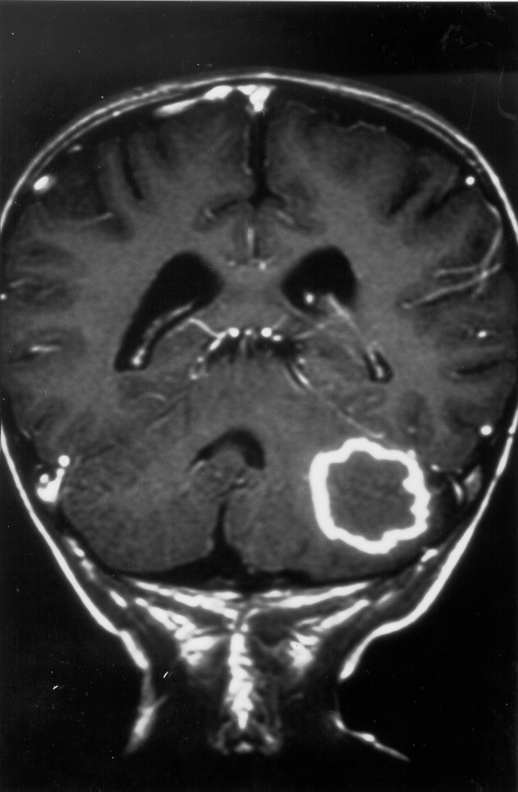
Consequences of TB disease If TB disease is curable, why is prevention so important?
Death
10% of TB patients do not survive¹
Disability
After treatment, patients have shorter life expectancy²
Over 60% of young children with TB meningitis have permanent disabilities³
Cost
50% are hospitalized
Direct medical costs are very large:
in CA, TB costs are over $200 million each year
¹Pascopella, Open Forum Infect Dis, 2014
²Hoger, Int J Tuberc Lung Dis, 2014; Shuldiner, Int J Tuberc Lung Dis, 2015
³Duque-Silva A, et al. JPIDS 2018. Outcomes of Pediatric Central Nervous System Tuberculosis in California, 1993-2011.

Slide 6
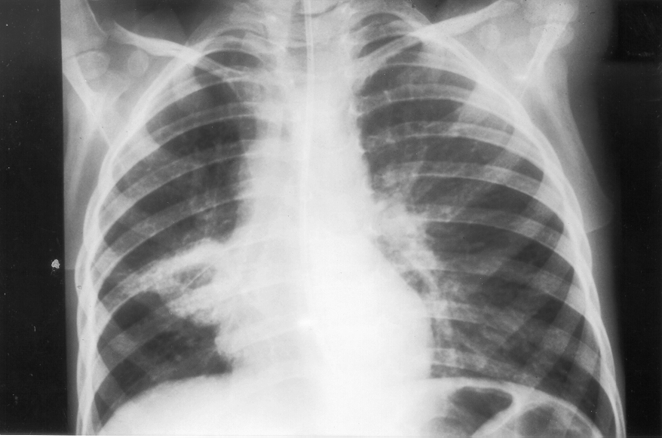
How common is TB in the United States?
TB is diagnosed every 2 hours
Every other day a person in the U.S. dies with TB
Each week at least one new child with TB disease
TB is preventable!

Slide 7
Natural History of TB
Not infected
13 million with LTBI in the U.S¹
Exposure to infectious TB
Latent TB infection (LTBI)
years
Active TB disease
Rapidly develop
active TB disease
¹Miramontes R, et al. (2015) Tuberculosis Infection in the United States: Prevalence Estimates from the National Health and Nutrition Examination Survey, 2011-2012.
Notes:
"Based on NHANES data, CDC estimates that up to 13 million people in the United States have latent TB infection."
https://www.cdc.gov/tb/statistics/ltbi.htm#:~:text=Based%20on%20NHANES%20data%2C%20CDC,States%20have%20latent%20TB%20infection.

Slide 8
A – Clearance
B – Latent infection
C – Pulmonary infection (active)
D – Disseminated infection (active)
Spectrum of TB disease
Active TB Disease
Symptoms such as cough, fever
TST or IGRA is usually positive
Chest radiograph is usually abnormal
Sputum is usually culture positive
Latent TB Infection
Absence of TB symptoms
Positive TST¹ or IGRA² result
Chest radiograph normal
Not infectious
¹TB skin test
²Interferon gamma release assay
Image: Dheda K. Lancet, 2016

Slide 9
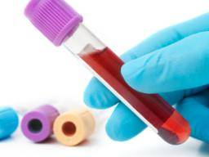
TB testing is now
more accurate
Opportunity
Treatment is now shorter and safer
Notes:
This time offers opportunity to prevent TB disease from occurring.
TB disease is preventable by testing and treatment.
Just recently our tests for TB infection became better and treatment is now much shorter and safer.

Slide 10
Patient and provider concerns
Patient
Patient feels well
Perception of risk: uncertain and not urgent
Worried about medicine side effects
Concerned about treatment cost
Provider
Lack treatment experience/ knowledge
TB not prioritized among competing problems
Notes:
Testing and treatment of LTBI is not new, so what are the barriers to TB prevention?
The patient does not feel ill while risk for TB disease seems uncertain or faraway.
Fear of taking a new medicine is common.
The busy primary healthcare provider is often overwhelmed and concerned about conditions other than TB. In addition, clinicians are often unclear how to test and treat. Guidelines both national and state have been confusing.
Finally, current tests and treatment are imperfect and can pose a cost to the patient.

Slide 11
The role of the civil surgeon
TB detection and prevention of spread is a critical role of civil surgeon
Civil surgeon is uniquely positioned to communicate to patient about LTBI when discussing test results
You can make a difference !
whether this patient develops TB disease in future
whether TB spreads and causes disease in young children
whether this patient’s infection is treated

Slide 12
LTBI diagnosis and reporting

Slide 13
Technical Instructions: what’s new?

Slide 14
TB screening for age >2
TB screening for age <2
Medical history and TB symptom screen
Physical exam
If signs or symptoms of TB present, or HIV-infected, need:
Chest x-ray (CXR) PA and lateral
TST or IGRA
Medical history and TB symptom screen
Physical exam
Interferon gamma release assay (IGRA)
If IGRA positive OR signs or symptoms of TB present, OR HIV positive, need:
Chest x-ray (CXR)
Notes:
You are responsible for completing a medical history, PE, and IGRA

Slide 15
Why is IGRA blood test being used?
Interferon gamma release assay (IGRA) improves accuracy
Blood test
QuantiFeron (QFT-plus) or T-SPOT
More specific than TST
No false positives from BCG
Result= Quantitative value
Positive or negative result
No need for return visit to read
Notes:
Can save individuals and health systems from unnecessary chest radiographs and treatment
Standard of care recommended by ATS/CDC Diagnostic Guidelines 2017

Slide 16
Interferon-Gamma Release Assays (IGRAs)
QuantiFERON®-TB Plus (QFT-plus)
Reported as positive, negative, or indeterminate*
T-SPOT.TB (T-Spot)
Reported as positive, borderline, negative, or indeterminate*
*For indeterminate test results:
Document indeterminate result;
Repeat test and chest x-ray not required by civil surgeon
Advise patient to have repeat test
Notes:
Update with QFT PLUS
Early secreted antigenic target 6 (ESAT-6)
Culture filtrate protein 10 (CFP-10)
TB7.7

Slide 17
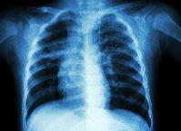
These findings are suggestive of TB disease
Cough > 3 weeks
Dyspnea
Weight loss
Fevers/sweats
Hemoptysis
Prior TB treatment
Kids:
Growth delay
More likely to have extra-pulmonary TB
1. Medical history
Lymphadenopathy
Abnormal vitals or pulmonary exam (non-specific)
Scars from scrofula
2. Physical exam
Infiltrate
Cavitary lesion
Nodule
Effusion
Hilar LAD
3. Chest x-ray

Slide 18
When my patient has a positive IGRA and abnormal CXR or TB symptoms
This patient needs sputum collected for AFB smear and culture
Refer patient to health department for sputum specimen collection to rule out TB disease
Report all persons with suspected TB to the health department

Slide 19
When my patient has: a positive IGRA and a normal CXR
Positive IGRA (without evidence of TB illness) = LTBI
LTBI must be reported to health dept
and
Talk to your patients about LTBI
LTBI detection is an opportunity to prevent TB
Facilitate treatment in your patient with LTBI

Slide 20
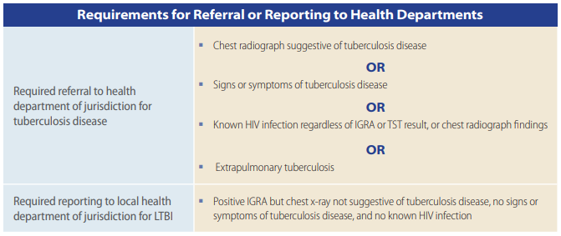
TB Technical Instructions for Referral/Reporting

Slide 21
A LTBI diagnosis should lead to a conversation with your patient
“You are infected with TB bacteria…”
A short course of treatment is recommended to prevent TB disease
If you prevent TB disease, then you will not get sick and spread TB to your loved ones

Slide 22
Key points for applicant evaluation for TB
You are required to:
Perform a medical history (including TB symptoms), physical exam, and IGRA on all applicants > 2
Perform CXR on those with positive IGRA or TB symptoms or HIV positive
Perform CXR prior to health department referral
Refer to health department to collect sputum if CXR has abnormality
Report to the health department:
Applicants with positive IGRA with a normal chest x-ray (LTBI)
Applicants with suspected TB disease (abnormal CXR OR symptoms OR HIV)

Slide 23
Treatment of LTBI and linkage to care

Slide 24
RULE OUT ACTIVE TB DISEASE BEFORE STARTING LTBI TREATMENT!!

Slide 25
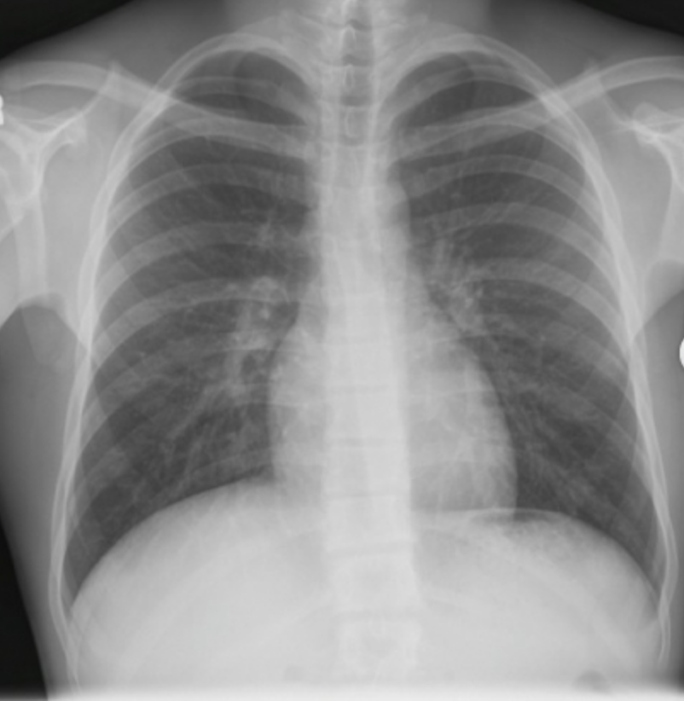
Case
67 yo woman born in Vietnam now adjusting her status
Previous HbA1c=6.0
Positive IGRA and CXR- normal
Should you treat her TB infection?
She is asymptomatic
Her CXR is normal

Slide 26
What is your next step?
Offer treatment with 9 months of INH
Offer treatment with 4 months of daily Rifampin (4R)
Offer treatment with 3 months of weekly INH + rifapentine (3HP)
Nothing, her evaluation is complete
Treat LTBI when possible
4R and 3HP are the first line regimens recommended for LTBI treatment in adults
(except if pregnant or HIV-positive)

Slide 27
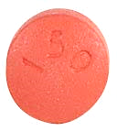
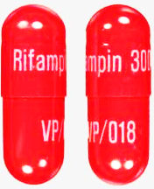
Treatment regimens for latent TB infection
Isoniazid + Rifapentine (INH/RPT)
(1 dose per week x 3 months)
Rifampin (RIF)
(1 dose daily x 4 months)
Isoniazid (INH)
(1 dose daily x 9 months*)
*6 months may be considered in specific situations

Slide 28
Rifamycins
Advantages
Less hepatotoxicity (~5x less than INH)
Greater adherence (78% RIF vs. 60% INH)
Disadvantages
Drug interactions
Warfarin, oral contraceptives, methadone, protease inhibitors, tenofovir alafenamide, and others
Hong Kong Chest Service/Tuberculosis Research Centre, Am Rev Respir Dis, 1992
Villarino, Am J Respir Crit Care Med, 1997 | Menzies, Ann Intern Med, 2008

Slide 29
Key Points
Short course rifamycin-based LTBI regimens –
12 dose regimen (3HP) or 4 months of rifampin
have higher completion rates
are less hepatotoxic than the older INH regimen
The short course LTBI treatments are preferred per CDC guidelines
Now on many healthcare plan formularies
Notes:
Treatment is much shorter, more likely to be completed and safer with less hepatoxicity.

Slide 30
Help your patient connect to healthcare for LTBI treatment
Options for LTBI treatment may include:
Civil surgeons may choose to treat LTBI
The status adjustor may have a medical home (primary provider) and prefer to receive care there
Health department clinic may offer LTBI treatment services
Other community clinics in the jurisdiction may provide LTBI treatment services

Slide 31
Communicating with patients with new LTBI diagnosis
“You have TB infection that can be treated”
“My office can refer you to a clinic for treatment if you do not already have a medical provider”
“Side effects are infrequent and can be managed”
Best Practice: Consider giving patient a card/letter with information on test results and treatment sites in patient’s preferred language

Slide 32
Summary
TB disease is still devastating
Untreated LTBI is the main driver of TB disease in the U.S.
Your role in TB detection and prevention is crucial
Rule out active TB and detect LTBI and communicate its importance to your patients
Report to your local/state health department:
Positive IGRA
Suspected and confirmed TB

Slide 33
Summary 2: LTBI treatment will prevent disease
The short regimens are preferred treatment for LTBI
4R or 3HP are as effective as 9 months of INH,
and have much better completion and lower hepatotoxicity
Rifamycin drug interactions may occur but can be managed
Many resources are available to you for treating LTBI

Slide 34
Resources
Civil Surgeon Technical Instructions:
https://www.cdc.gov/immigrantrefugeehealth/civil-surgeons/tuberculosis.html
QAP mail box: gapcivilsurgeons@cdc.gov
USCIS Policy Office box: opscivilsurgeons@uscis.dhs.gov
US Public Health Department TB programs: https://www.cdc.gov/tb/links/tboffices.htm
CDC TB Centers of Excellence: https://www.cdc.gov/tb/education/tb_coe/default.htm
NTCA LTBI guidelines: https://www.cdc.gov/mmwr/volumes/69/rr/rr6901a1.htm
TB Free California: https://www.cdph.ca.gov/Programs/CID/DCDC/Pages/About-Us.aspx

Slide 35
Acknowledgements
Thank you to :
[INSERT ACKNOWLEDGMENTS]

