Slide 1

Introduction to Effective Contact Investigation Strategies
Anne Cass, MPH
Stephanie Spencer, MA
Program Development Section
TB Control Branch
California Department of Public Health
March 2019

Slide 2
Objectives
Identify at least three essential components of a TB interview
Be able to name words that elicit open dialogue between the health care worker and patient
Demonstrate the ability to use effective communication techniques to elicit household and non-household contacts

Slide 3
Disclosures
The faculty have no conflicts of interest to disclose

Slide 4
Why Do We Conduct Contact Investigations (CI’s)?
To identify additional TB cases
To identify patients with latent TB infection (LTBI)
To prevent the further spread of TB
To prevent illness and death from a preventable disease

Slide 5
Contact Investigations:
Every TB Case Began as a TB Contact
TB Index Patient
TB Patient
TB Contacts
TB Patients
TB Contacts
Notes:
Slide Notes:
The purpose of a TB contact investigation is to:
Identify, examine and evaluate all persons who are at risk of infection with Mycobacterium tuberculosis due to recent exposure to a diagnosed or suspected tuberculosis case patient
Identify new cases of TB disease
Allows for early treatment of disease, and early detection and treatment of new TB infection. In some cases, it may prevent infection
Interrupt and halt further TB transmission
Slide adapted from CDC slideset

Slide 6
Contact Investigation
Performance Targets and Outcomes
 | 2020 National Targets | 2016 California Outcomes
Contacts identified | 100% | 93%
Contacts fully evaluated | 93% | 80%
Contacts to smear + cases initiating LTBI Rx | 91% | 67%
Contacts to smear + cases completing LTBI Rx | 81% | 72%

Slide 7
5 Steps in Conducting a
TB Contact Investigation

Slide 8
TB Contact Investigation Steps
Collect and Evaluate Index Case Information
Interview the Index Case and Determine the Infectious Period
Prioritize Contacts
Locate, Evaluate and Treat Contacts
Evaluate Contact Investigation Activities
Notes:
8
Slide Notes:
The 5 basic steps listed here outline the contact investigation framework.
We’ll be going through each one of these in more detail.
Begins with: Gathering information already known about the case or suspect
Ends with: analyzing all information obtained through the interview process and reviewing transmission details for the contacts.
After doing all of these, you will be able to determine if additional steps need to be taken to halt any additional transmission

Slide 9
Step 1: Collect and Evaluate
Index Case Information
Notes:
9
Slide Notes:
Anne start here

Slide 10
Collect and Evaluate Index
Case Information
Determine urgency
Review disease related information
Calculate possible infectious period
Consider settings of potential transmission
Notes:
What are the sources of this information:
CMR & intake form
Other medical records, hospital records
Communication with provider
Disease-related information
Is the index case infectious? Symptomatic?
Information re: settings in which the index case may have transmitted TB (if available)
As above, “if available” b/c limited or no information re: settings of potential transmission may be available. However, we do sometimes receive information from a provider, e.g. if the patient works in a day care center or residential AIDS facility If your case works is infectious and works in a day care center, you’d probably prioritize this case over a non-infectious case that is suspected to have few contacts.

Slide 11
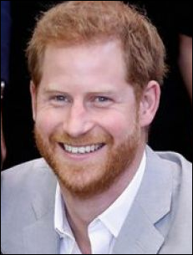
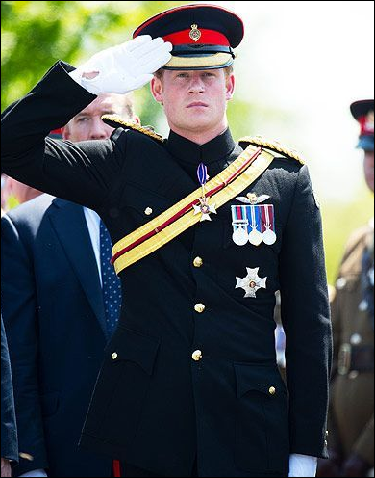
Initial case report:
Received from King Edward VII’s Hospital 12/1/18
Patient: Prince Harry Windsor
Occupation: Former soldier with 2 tours in Afghanistan
Diagnosis: smear +, cavitary TB
Symptoms: fatigue, cough x one month
Started on anti-TB treatment 12/1/18
Notes:
So this is the scenario of a case that gets reported in to the health department on a ‘MMR’ of phone call, with some basic information

Slide 12


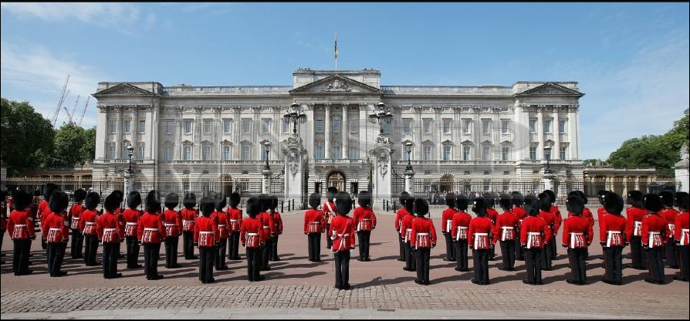
Planning for a TB Interview
Notes:
Final definition is one most are familiar with, and that is the British royal family. To refresh your memories, and for those who were not followers of the program, her are some basics about what you need to know, and we will be using it as an example of a TB investigation. I also want to acknowledge that during this presentation, we touch upon some basic TB information, and will not have the time nor is it the intention of this presentation to have all of you be TB CI experts. There are some participants who work in TB control, and want those of you to be especially aware of our intention to leave of some detailed information regarding TB and a CI that would normally be included if this were a TB specific training (e.g. boosting, class IIs among foreign borne, source case investigation of a child class II etc) The intention is to think thru some fundamental contact investigation concepts using TB CI as an example.

Slide 13

Step 2: Interview the Index Patient and Determine Infectious Period
Notes:
13
Slide Notes:
Anne start here

Slide 14
Interview Components
Establish rapport/discuss confidentiality
Provide TB education
Explain purpose & process of contact investigation
Determine infectious period
Identify potential transmission settings and exposed contacts
Prioritize contacts for evaluation
Notes:
Objectives TB Ix: Education – important for pt. to have comfortable knowledge of TB e.g. how disease is spread; completing Rx; identify length of infectiousness in order to gather as much understanding of patient’s potential contacts in the entire infectious period which might sometimes be a year or greater; understand where patient spends a lot of time and the environment of those locations, discuss day to day activities/routines of patient; identify contacts and those at greater risk of being infected with TB/developing disease e.g. children, immunosuppresed, contacts spending the most time with patient in enclosed settings.
Interviewing begins with good communication showing that you are listening to the Pt., asking open ended questions, problem solving for concerns that arise In the end we want to keep dialogue open and be conscious of what can keep dialogue closed and the health worker doing all the talking. The more the patient talks, the more information can be identified and sources/spreads to disease can be id’d.. Point out importance of using open ended questions to keep dialogue open
Rapport:
Confid:
Purpose of CI: describe importance of clearly explaining purpose and process of CI index case thur clarification of any misconceptions the case might that are affecting their understanding about who a contact is and why it is essential to locate and evaluate the contact– Robin’s article.
Want to keep in mind when interviewing someone to identify sources, spreads/contacts at home, work and leisure.
Comment: describe importance of clearly explaining purpose and process of CI inde

Slide 15
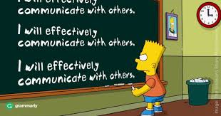
Effective Communication
Techniques
Notes:
Slide Notes: Anne
Contact investigations involve ongoing conversations between the CM and others involved in the patient’s care (CDI, DOT worker, Program Manager, TBC etc.)
Also the CM or others communicate with providers and others who work with the case. (laboratories)
So lets take a few minutes to talk about some techniques that will be helpful for this process and while doing your job.
It is important to use these techniques with all who you communicate with (practice using them with your partner or kids)

Slide 16
Key Technique #1:
Using Open-Ended Questions
Closed - Ended Questions
    Elicit a “yes” or “no” answer
    Can you? Will you? Do you? Could you? Are there?
    Have you ever …???
Open - Ended Questions
    Elicit an answer with more information than just a “yes” or “no”
    Begin with: Who? What? When? Where? How? Why? or with:
    Describe…or Tell Me
Notes:
In my opinion the most important communication technique that we will talk about today. Also the hardest to learn and apply
Slide Notes: Animated Slide
What is a closed vs. open ended question, give examples
Discuss how the use of open ended question during interviewing will allow the patient to talk more.
Open ended questions end in the patient talking more than the interviewer getting more information than just what was asked
May lead the conversation to getting additional contacts and identify obstacles/problems e.g. completion of therapy; confidentiality concerns.
Like a class that teaches a new language where the participants are asked to speak almost exclusively in that language, lets do our best to ask all questions about the class and its content today in an open-ended fashion

Slide 17

Tell me about….. Describe….

Slide 18
Where Should the Interview Take Place?
Should be conducted in person (face-to-face)
  Hospital
  TB clinic
  Residence
  Other location
At least one interview should be conducted in the TB patient’s residence
Notes:
Slide Notes:
Review slide content
Clarify that the initial interview should be done wherever the case is during that time frame (next slide will cover Ix timeframes)
Explain to participants that it is very important to conduct an interview in the case’s home or living space because it can help them to identify clues that may suggest there are more contacts (e.g., pictures of children, toys laying around)
18

Slide 19
Identify Contacts
Home, work, school, leisure settings
Remember to ask about:
  Travel
  Social activities
  Recreational activities

Slide 20
Your Turn:
Plan and Conduct an Interview
Work with a partner to come up with 2 open-ended interview questions for Harry
His symptoms began 11/1/18
  → Infectious period began 8/1/18
Roundtable interview of Prince Harry
Notes:
So you have obtained thru the initial report some basic information about Harry, now you need to plan to interview him. So what are your next steps, and go thru for group discussion the questions in the slide
Anne play Harry
Stephanie facilitate questions

Slide 21
Tell me about….. Describe….

Slide 22
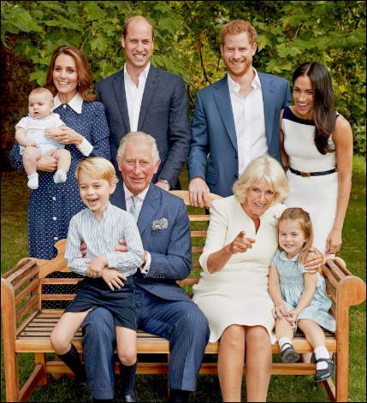
Interview Findings
Household contacts
  Royal family + staff
Work:
  Former military (Afghanistan, 2013)
  Extensive charity work
Leisure
  Used to frequent bars
  Now mostly hangs out w/ Meghan & a 3 old friends from school
Notes:
After your initial interview with Harry, these are what you find, and what he shares with you. Note the Harry is a wealth of trivial information, and importance of establishing rapport is part of him sharing his trivial info. It is equally important to try and stay focused on the interview. Presenter to mention interview training TBCB offers which focuses more on TB interview process
Family: Queen Elizabeth, Prince Philip, Prince William, Duchess Meghan, Duchess Kate, Prince Charles, Duchess Camilla, George (5), Charlotte (3), Louis (9 mo’s)

Slide 23
Step 3:
Prioritize Contacts

Slide 24

Factors Used to Prioritize Contacts
Consider:
Infectiousness of the TB case
Circumstances of the exposure
  Environment
  Frequency and duration of exposure
Contact factors
  Age, immune system status
Infectiousness
Exposure Intensity
Susceptibility
Notes:
Slide Notes:
We talked about the TB case factors and what case characteristics increase the likelihood that TB transmission can occur (smear positive, cavitary disease, etc.).
We also talked about the environmental factors that may increase the likelihood that transmission of TB may occur (small shared airspace, no UV light, low air circulation, etc.).
Now we’re going to look a bit closer at:
how frequent and for how long was the exposure and
susceptibility factors such as age and immune system status.

Slide 25

Priority Classification
High-priority contacts are defined as those:
Most likely to be infected
Most likely to progress to disease if infected
Notes:
Slide Notes:
All contacts should be given a priority classification of either high, medium or low. This will help you to keep your focus on those contacts deemed high priority. Some counties will attempt to get all high and medium priority contacts evaluated.
Keeping all of the information about the contacts can be cumbersome. Using a form called a contact roster is generally the most efficient and useful way to keep track of the contacts to each case.
Contacts at high risk for rapid progression to active TB
Rosters usually include space for Index case information- including dates of the IP
And contact information such as the name, DOB, address, priority, where exposure occurred, evaluation info and dates.

Slide 26



High Priority Contacts
Children under age 5
Persons with HIV or other immunosuppressive medical conditions
Notes:
TB disease is more likely to occur once infected
Can progress from infection to disease very rapidly
Can have serious negative outcomes

Slide 27
Prioritization of Harry’s Contacts
High Priority | Medium Priority | Low Priority
Wife Meghan Royal family, esp George, Charlotte and Louis Staff with most frequent contact Charity work colleagues with most frequent contact | Staff and charity work colleagues with less frequent contact Friends that visit Windsor Estate occasionally | The public

Slide 28
Step 4:
Locate, Evaluate and Treat Contacts

Slide 29
Evaluation of Harry’s Contacts
High Priority | Medium Priority
Wife Meghan – active TB Royal family: George, Charlotte and Louis (all have LTBI) Others all negative Closest staff (2 of 6 found to have LTBI) Closest colleagues from charity work | Staff with less frequent contact Charity work colleagues with less frequent contact Friends that visit Windsor Estate
Notes:
Secondary case(s) of TB disease – Note: in CA LHDs are required to report when there are 3 or more TB cases that are suspected or confirmed to be linked. The State TB Control Branch has an Outbreak Team that tracks clusters and outbreaks of TB in our state, and this team can also provide on-site direct assistance to LHDs if requested.
In addition to epi links identified, all culture positive TB cases should be genotyped to identify possible transmission that may not have been detected through epi links identified through the CI. All TB cultures should have a specimen sent from the public health lab for genotyping—testing that can confirm whether they are of the same strain. (Note: CA law requires all TB cases to have a sample sent to the public health lab.)
The CDC has just recently initiated “universal genotyping” – e.g. testing of all active TB case isolates to determine bacteriological links that possibly might not have been evident without this add’l lab testing.
How do you think Andrew Campion, Stable Master, got infected? He and Prince Harry grew up together. Harry hung out with him a lot before his marriage—evening at Andrews cottage, and still spent a few Sunday evenings with him after his wedding.

Slide 30
Step 5:
Evaluate Contact Investigation Activities and Expand (if Indicated)

Slide 31
Evaluate
Was there evidence of transmission?
Re-Interview
  Clarify initial interview information
  Address gaps
  Should additional contacts be tested?
Notes:
Note that your initial testing is completed and all contacts found to have TB infection or disease have been started on Tx, it’s time to step back and assess your results so far.
Case analysis –read bullets
Re-ix – very important step –esp. For a disease as complex as TB. Info. Obtained in re-ix will help you plan your next steps for the CI.

Slide 32
Evidence of Transmission?
Household
  Wife with active TB
  Close family + staff with LTBI
  Ensure that the closest contacts are all tested and start LTBI treatment
  Identify and pursue additional family and staff contacts
Work and Leisure contacts
  No evidence of transmission
  No additional effort needed

Slide 33
References and Resources
Patient interview guide
  Available upon request from the TB Branch
CTCA Contact Investigation guidelines
  https://ctca.org/guidelines/cdph-ctca-joint-guidelines/
Rutgers TB Center of Excellence materials
  http://globaltb.njms.rutgers.edu/educationalmaterials/productlist.php
CDPH TB Control Branch staff:
  Anne Cass: anne.cass@cdph.ca.gov
  Stephanie Spencer: stephanie.spencer@cdph.ca.gov

Slide 34
Questions?

