Slide 1
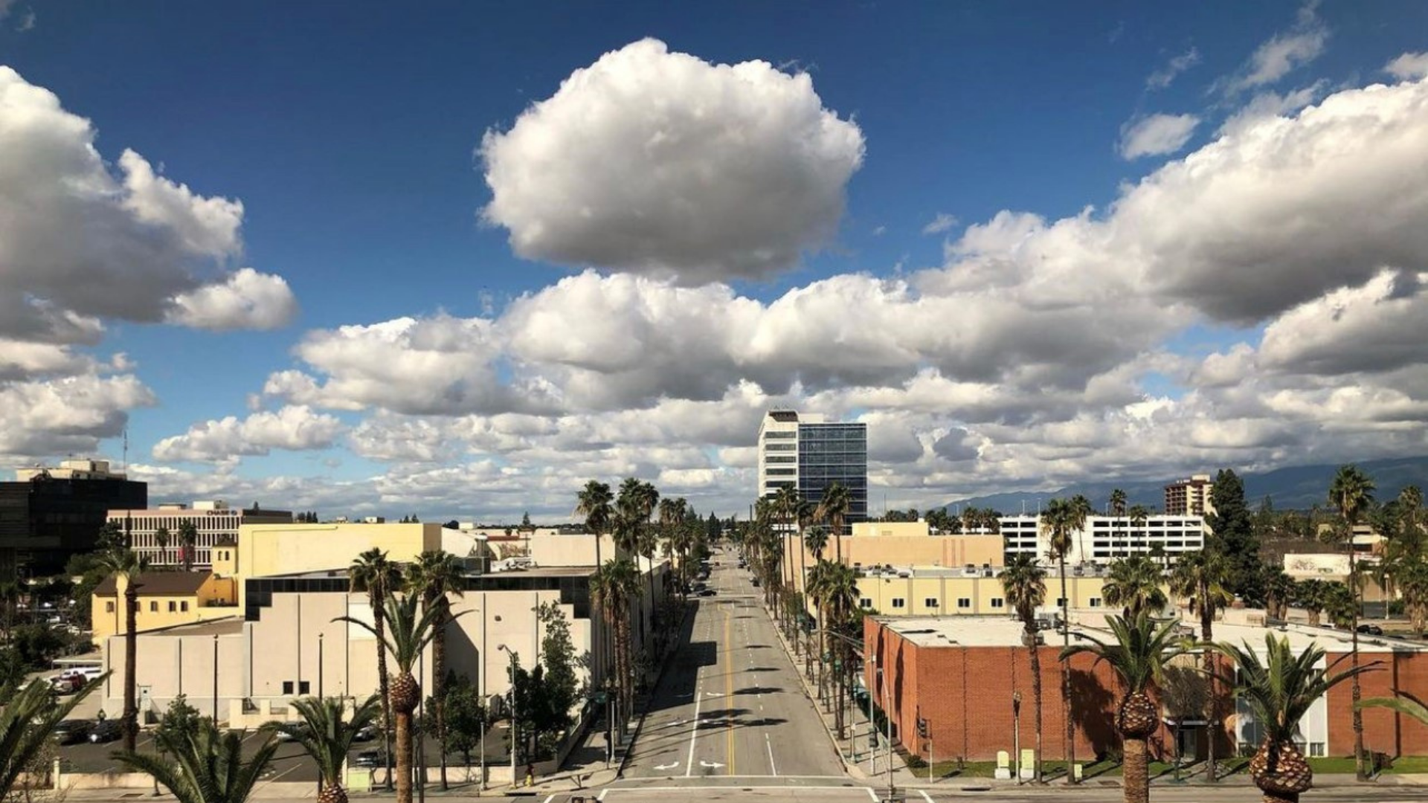


Creating A CalREDIE Query For Nurse Assignments
Jenny Hernandez
MSN, BSN, BAS, RN, PHN, AMB, LNC
SPHN
Step-by-Step Workflow
SBCounty.gov

Slide 2

Objective
Retrieve a list of tuberculosis cases within a specified date range to:
Count nurse caseloads
Track assignment dates
Calculate treatment dates
Reassign cases if needed
Create a PHN case ratio
2

Slide 3
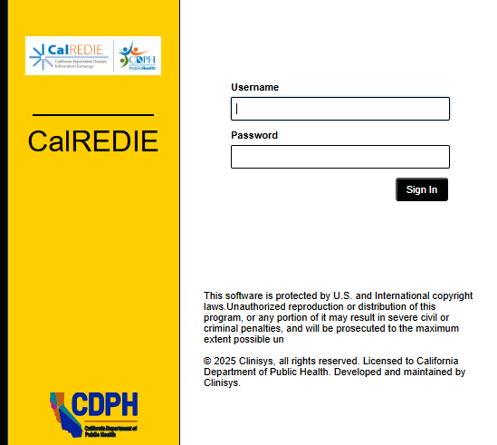
Step 1A: Access & Initial Navigation
1. Log in to CalREDIE
3

Slide 4

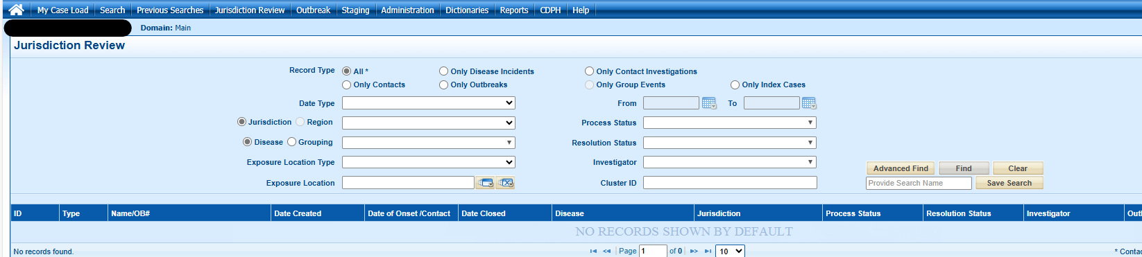
Step 1B: Access & Initial Navigation
2. Open “Jurisdiction Review” and click “Open”
4

Slide 5
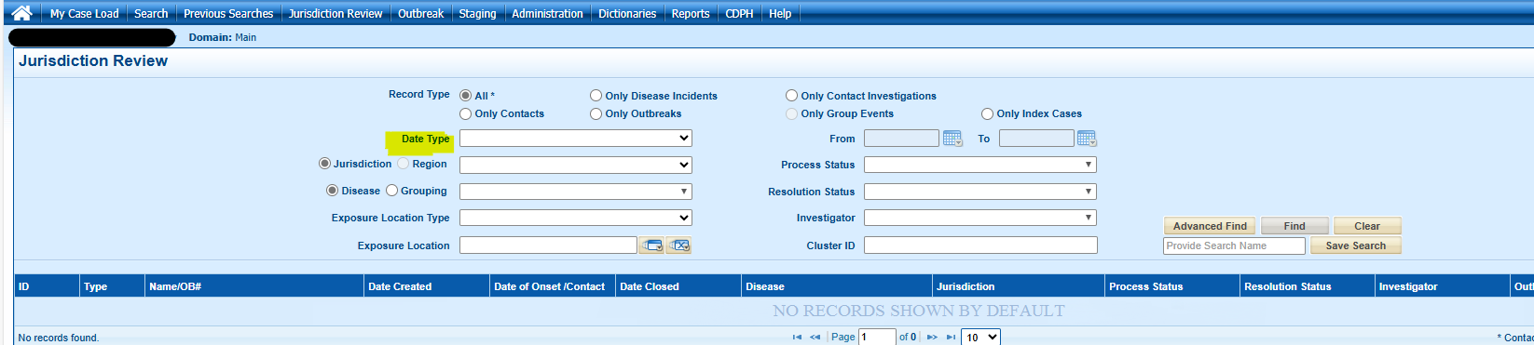
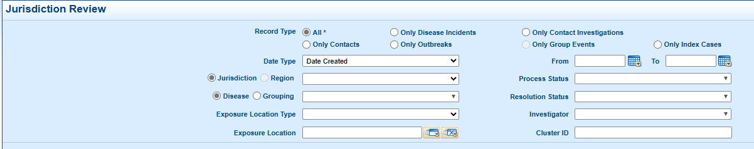
Step 2: Define Date Criteria
Click on "Date Type"
2. Select "Date Created"
5

Slide 6
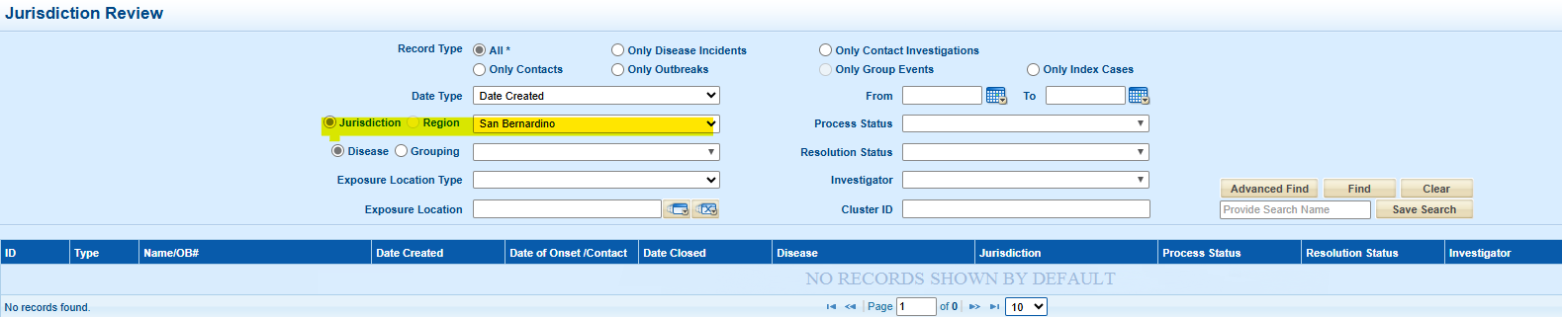
Step 3: Filter by Jurisdiction
1. Click 'Jurisdiction’
2. Select your County
6

Slide 7
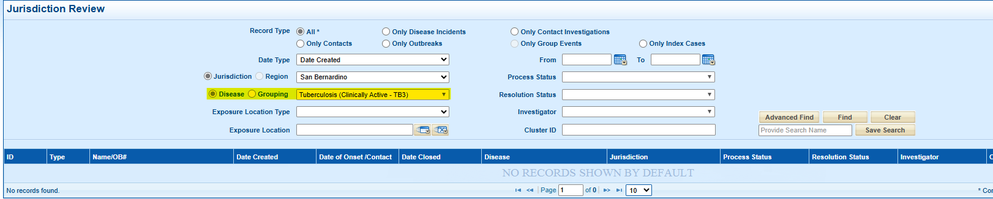
Step 4: Set Disease Criteria
1. Scroll to 'Disease' section
2. Select 'Tuberculosis Clinically Active TB3'
7

Slide 8

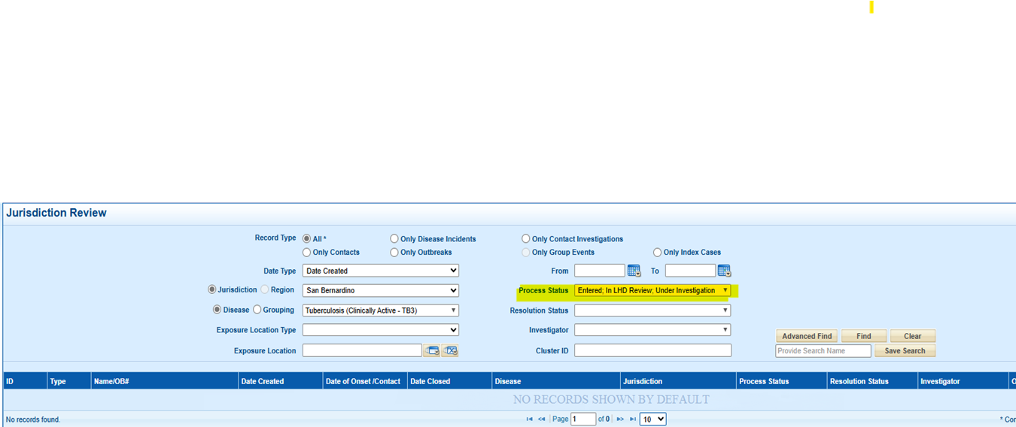
Step 5: Specify Process Status
1. Locate "Process Status"' section
2. Select:
"Entered, Under Investigation"
"In LHD Review"
8

Slide 9

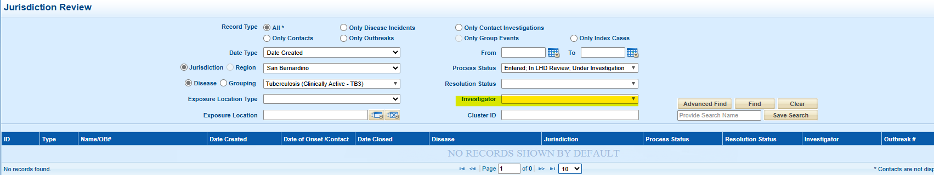
Step 6: Filter by Investigator
1. Scroll to 'Investigator'
2. Select case managers
9

Slide 10

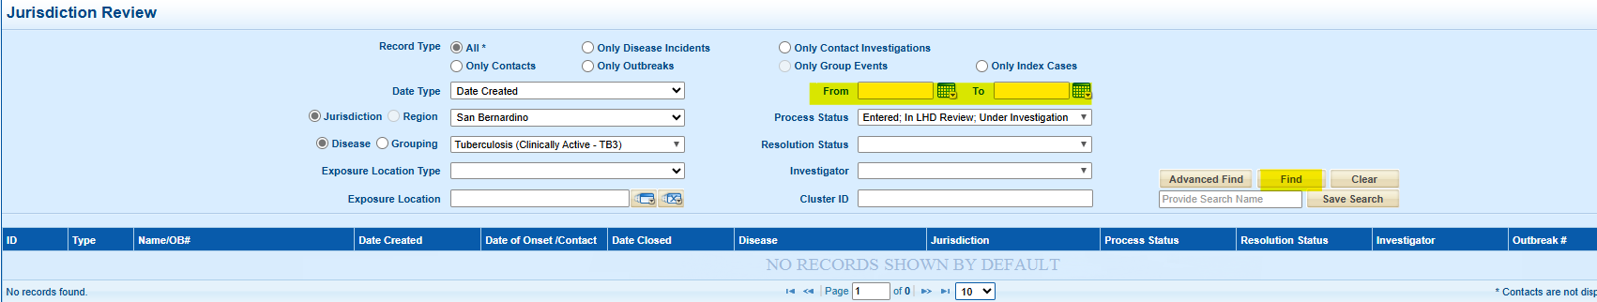
Step 7: Set Date Range & Run Query
Input date range (e.g., Jan 1, 2025 - Jan 31, 2025)
Click 'Find' and review results
10

Slide 11
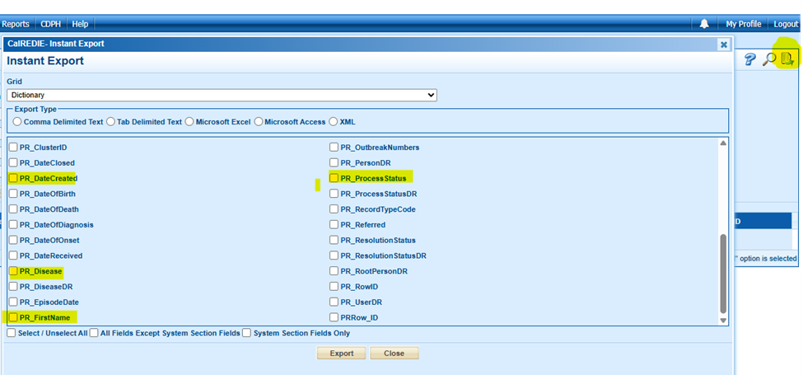
Step 8: Export the Query
1. Click 'Export'
2. Choose 'Microsoft Excel'
3. Select fields to export:
PR_date created
PR_disease
PR_first name
PR_investigator
PR_last name
PR_process status
4. Click 'Export' and save file
11

Slide 12

Step 8: Export the Query Contd.
12

Slide 13

Step 9: Post-Export Data Management
Open Excel file and analyze data
Count nurse caseloads, track dates, and reassign cases
Create PHN case ratio
13

Slide 14
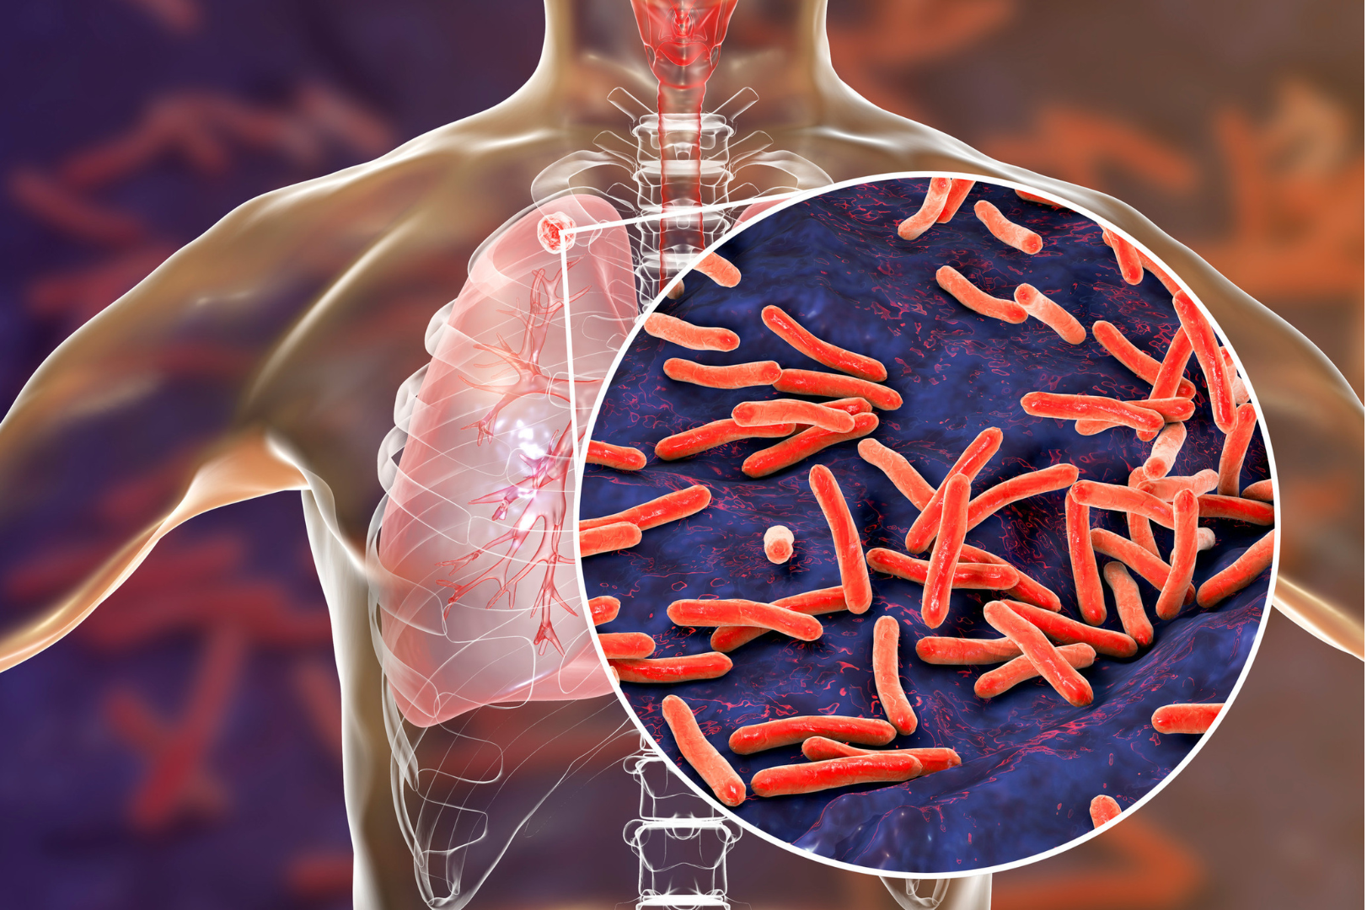
Conclusion
Following this workflow ensures effective case management and tracking of tuberculosis cases.
14

Slide 15

Contact Information
Jenny Hernandez, MSN, PHN,
Supervising Public Health Nurse, San Bernardino County Public Health, Communicable Diseases Tel: (800) 722-4794, Fax (909) 381-8471 jhernandez@dph.sbcounty.gov
Rocio Agraz-Lara, MSN, RN, PHN
San Franscisco Department of Public Health,
Population Health Division, Disease Prevention and Control, Tuberculosis Control
Tel: (628) 206-8524, Fax: (628) 206-4565
rocio.agraz-lara@sfdph.org

Slide 16

THANK YOU

