Slide 1
DHCS MOU Template between MCPs and LHDs
Phuong Luu, MD, MHS, FACP
Bi-County Health Officer
Yuba County and Sutter County
CTCA Executive Committee Member
October 2, 2023

Slide 2
Terminologies
DHCS = Department of Health Care Services, the State agency that administers Medi-Cal
MCPs = Medi-Cal Managed Care Plans. By January 1, 2024, it is projected that 99% of all Medi-Cal beneficiaries will be enrolled within Medi-Cal Managed Care. Only 1% will remain as Fee-for-Service.
LHDs = Local Health Departments

Slide 3
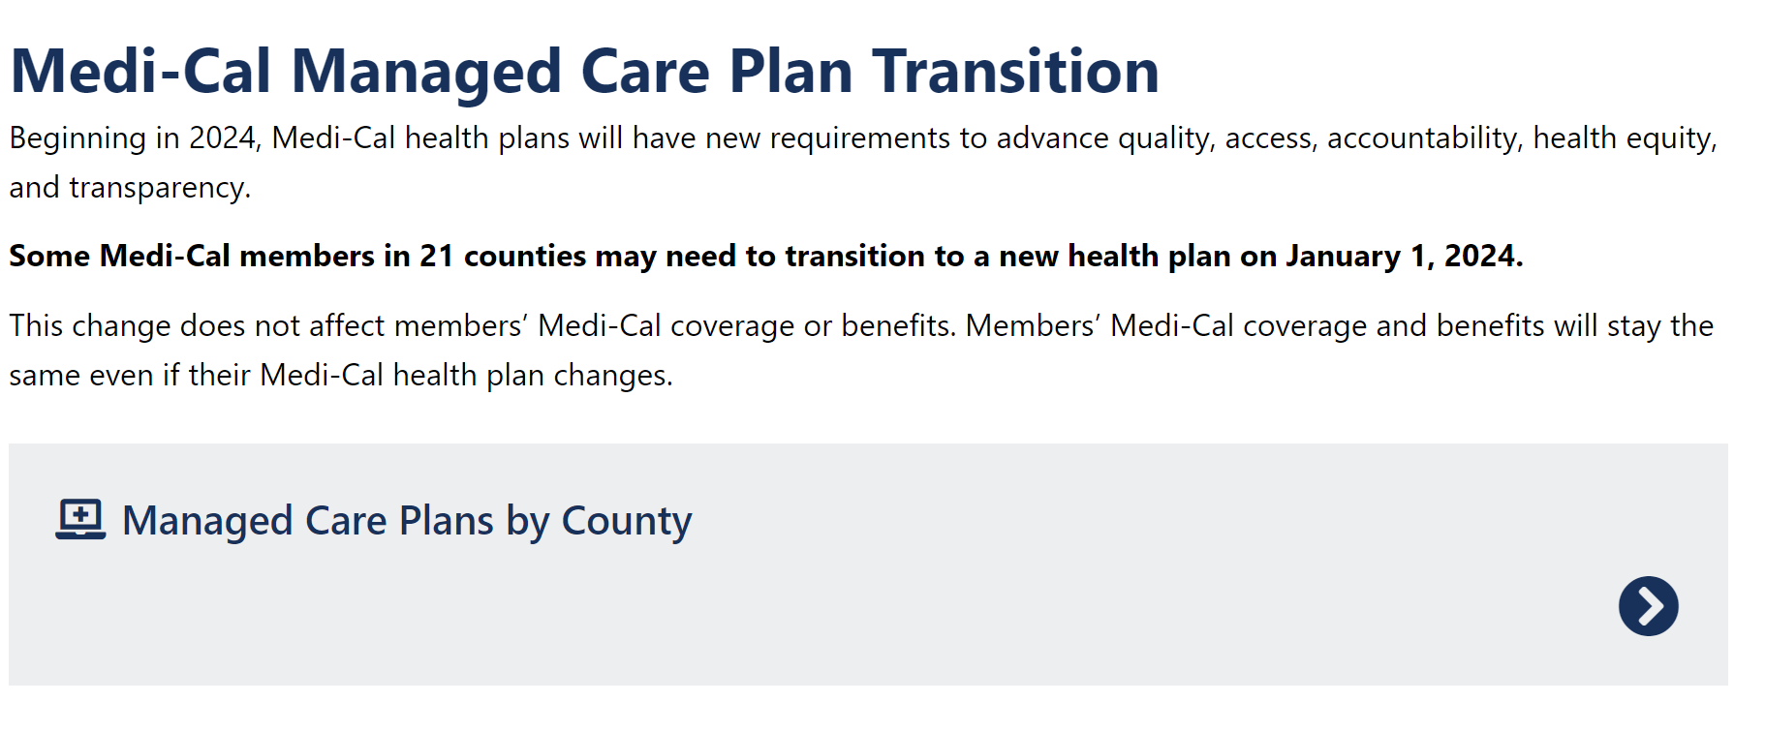
Medi-Cal Managed Care Plan Transition
https://www.dhcs.ca.gov/MCP-Transition/Pages/Home.aspx

Slide 4
DHCS MOU between MCPs and LHDs
DHCS requires all MCPs to execute an MOU with each LHDs in all counties that they are providing Medi-Cal benefits
This is one of 16 MOUs DHCS is requiring MCPs to execute with various local agencies including county public health, county behavioral health, county child welfare, and IHSS
Is this a new thing? – No! LHDs have had executed MOUs with MCPs for many years now.

Slide 5
Components in MOU Related to TB
Technical Assistance and Provider Training
TB Screening
Reporting of Known or Suspected TB Cases
TB Treatment
Reimbursement.
MCP must reimburse LHD for diagnostic and treatment services, if applicable, as specified in Section [__] under its Network Provider Agreement with the LHD.
MCP does not cover DOT. LHD must submit claims for reimbursement of DOT services directly to the state Medi-Cal program.

Slide 6
Timeline
July-August 2023
DHCS asked through CHEAC for LHDs’ consolidated feedback regarding the draft MOU template
Very soon (likely October 2023)
Final MOU template for MCPs/LHDs will be released by DHCS
October-December 2023
December 2023-Early 2024
Review final MOU, focusing on TB components
Provide feedback to your LHD POC negotiating with the MCP(s)
MOU executed between LHD and MCP. One MOU per MCP.

Slide 7
Questions?

