Slide 1
Update on the Revision of U.S. Guidelines for the Treatment of Latent TB Infection
Randall Reves
University of Colorado Denver
Denver Public Health Volunteer Physician
Conflicts of Interest: none
California Tuberculosis Controllers Association
2019 Educational Conference
Rohnert Park, CA, March 12, 201

Slide 2
Topics for discussion of treatment recommendations for TB prevention
History of US recommendations for INH treatment
Focus on IUAT RCT trial: older adults with fibrotic lesions
Developments since “recent” 2000 “LTBI” guidelines
“Current” 2011-2019 guideline process
Update presented to ACET by Tim Sterling, Dec. 2018
Guideline members for “What to use for LTBI treatment”
Acknowlegements

Slide 3
Historical background: 12-6-9-?
1965 – ATS recommended 12 mo. of INH for “preventive therapy”
Inactive pulmonary TB
recent TST converters
children < 3 yr
1967 – “chemoprophylaxis” for all with TST > 10, mandatory for:
Inactive, untreated TB & their contacts
TST converters
selected medical conditions
anyone age < 20 yrs
1974 – INH hepatitis, fatalities➔
exclusion if > 35 yr without increasedTB risk
1982 – IUAT trial published

Slide 4
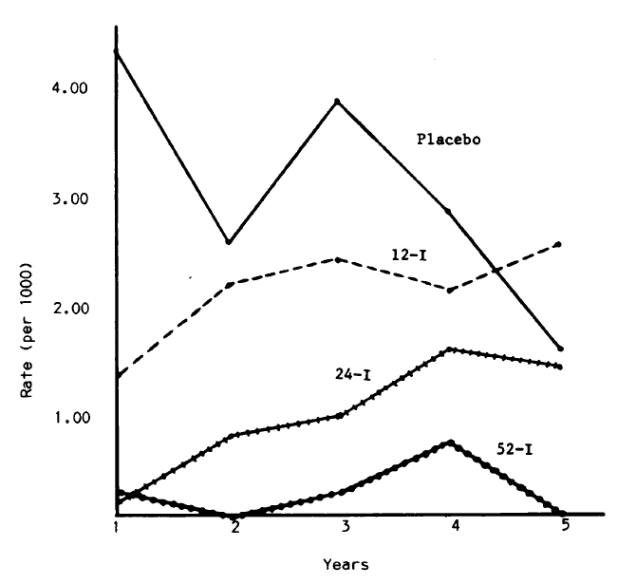
IUAT trial* in E. Europe: the only RCT of 12 vs 6 INH
RCT: Placebo, 4, 6, 12 mo. INH
28,000 persons, median age 50 yr
Stable “fibrotic lesions”, TST > 5
Complied: 90, 80, 70% - 4, 6, 12
97% 5 yr. follow-up
TB cases: 231
76, 34, 24 on 4, 6, 12 mo arms
97 on placebo, 3 fatal
Hepatitis: 102
95 on INH – not provided by arm!
3 fatal
4 mo.INH – two
12 mo. INH – one
TB per 1,000 py among “compliers”
*Bull WHO 1982;60:555-564

Slide 5
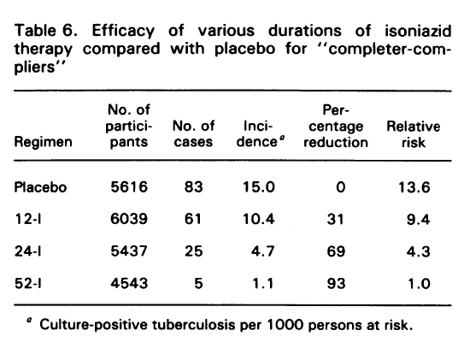
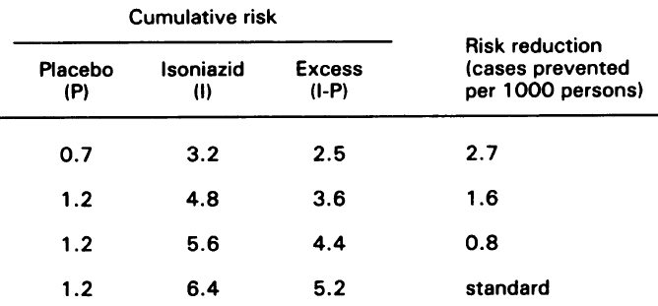
Historical background: IUAT trial
Table 3. Risk of INH hepatitis by quarter
Cumulative INH hepatitis risk per 1,000
6 mo. - 3.6
9 mo. - 4.4
12 mo. – 5.2

Slide 6
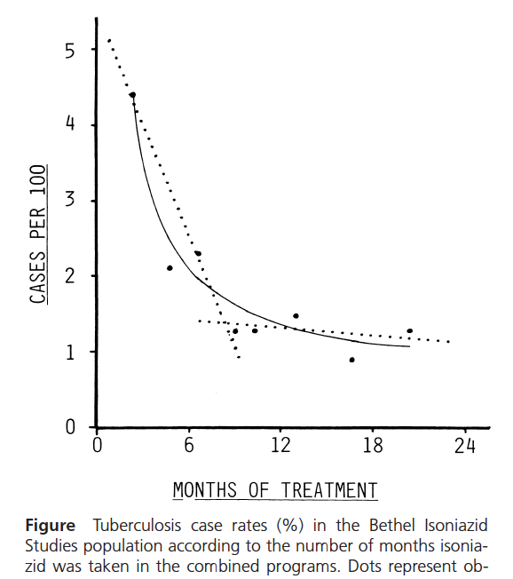
Historical background: 12➔6 or 12, ? 9 mo.
1983 – Clinical & lab monitoring for person > 35 yrs
1986 – INH 6 or 12 mo.
6 more cost-effective
1999 – Comstock proposes 9 months from retrospective analysis of data from Bethel INH Studies (G. Comstock IJTLD 1999)

Slide 7
Historical background: 12➔ 6 or 12➔ 9 mo.
Most recent guidelines from ATS/CDC in 2000 rec 9 mo INH:
Targeted tuberculin testing and treatment of latent tuberculosis infection.
Am J Respir Crit Care Med 2000;161(4):S221-S247.
Since then:
2RZ no longer recommended due to risk of severe hepatotoxicity
Compared to 6H or 9H, regimens of 3HP, 4R, and 3HR demonstrated to be
As effective
More likely to be completed
At least as safe
Most treatment regimens have not been compared head to head, but they have been compared by network meta-analysis
Stagg HR et al. Ann Intern Med 2014.
Zenner D et al (updated). Ann Intern Med 2017

Slide 8
Background: current revision*
ATS/IDSA/CDC started treatment guidelines in 2011, but ATS and IDSA withdrew in December 2016.
GRADE criteria did not fit well with “whom to treat for LTBI”, or “how to ensure treatment”, topics which will be addressed elsewhere
This document focuses on which regimens to use to treat LTBI, a topic for which GRADE criteria are more appropriate
Neither WHO 2018 LTBI guidelines, nor the recent network meta-analyses, include recent 4R data on safety and effectiveness.
NTCA and CDC recognize the importance of LTBI guidelines for TB practitioners in the United States and other countries
*As presented at ACET in December 2018 by Tim Sterling.

Slide 9
Evidence evaluation and recommendations*
Clinical question written in the PICO format
Population, intervention, comparator, outcomes
“Which regimens have the greatest effectiveness and least toxicity?”
Outcomes: TB disease (effectiveness) and hepatotoxicity (toxicity)
Importance rated as critical, important, or not important
Systematic literature review: MEDLINE, Cochrane Central Register of Controlled Trials (CENTRAL), Google Scholar
Updated June 5, 2018 (including 4R data from Dr. Menzies; published in July)
Grading of Recommendations Assessment, Development and Evaluation (GRADE) to appraise evidence quality
*As presented at ACET in December 2018 by Tim Sterling.

Slide 10
Evidence evaluation and recommendations*
GRADEpro was used to develop evidence profiles summarizing the quality of the evidence:
High, Moderate, Low, Very low
Recommendations:
Strong
Vast majority of patients would choose
Requires at least moderate quality evidence
Further studies unlikely to change recommendations
Conditional
Uncertain if desirable consequences outweigh undesirable consequences
ex: low quality evidence for critical outcome
Further studies may change key findings, and hence change recommendations
*As presented at ACET in December 2018 by Tim Sterling.

Slide 11
GRADE evidence tables*
Head-to-head comparisons of regimens evaluated in clinical trials, according to the populations studied:
Adults/children; HIV-positive/negative
The committee prioritized the GRADE evidence tables according to the regimens, comparisons, and study populations that were deemed most clinically relevant to the U.S., Canada, and other low TB incidence populations
The committee prioritized the GRADE head-to-head comparisons over the network meta-analysis results, but reviewed both
*As presented at ACET in December 2018 by Tim Sterling.

Slide 12
GRADE Evidence Tables* Higher priority for the committee
Experimental Regimen | Comparator Regimen | Population | No. of trials Effectiveness | No. of trials Toxicity
3HP | 9 months INH | HIV-positive adults | 1 | 1
3HP | 9 months INH | HIV negative adults and children | 1 | 1
3HP | 9 months INH | HIV negative children | 1 | 1
3HP | 6 months INH | HIV-positive adults | 1 | 1
*As presented at ACET in December 2018 by Tim Sterling.

Slide 13
GRADE Evidence Tables* Higher priority for the committee
Experimental Regimen | Comparator Regimen | Population | No. of trials Effectiveness | No. of trials Toxicity
3HR | 9 months INH | HIV-negative adults | 1 | 1
3HR | 6 months INH | HIV negative adults and children | 3 | 2
3HR | 6 months INH | HIV-positive adults | 4 | 4
3HR | Placebo or no treatment | HIV-positive adults | 2 | 1
3HR | Placebo or no treatment | HIV negative adults and children | 2 | 0
*As presented at ACET in December 2018 by Tim Sterling.

Slide 14
GRADE Evidence Tables* Higher priority for the committee
Experimental Regimen | Comparator Regimen | Population | No. of trials Effectiveness | No. of trials Toxicity
4R | 9 months INH | HIV-negative adults | 1 | 2
4R | 9 months INH | HIV-negative children | 1 | 1
4R | 6 months INH | HIV-negative children | 1 | 0
6H | Placebo | HIV-negative adults and children | 4 | 2
6H | Placebo or no treatment | HIV-positive adults | 5 | 3
9H | No treatment | HIV-negative adults and children | 2 | 0
*As presented at ACET in December 2018 by Tim Sterling.

Slide 15
GRADE Evidence Tables* Lower priority for the committee
Experimental Regimen | Comparator Regimen | Population | No. of trials Effectiveness | No. of trials Toxicity
12 months INH | No treatment | HIV-positive adults | 2 | 0
12 months INH | Placebo | HIV-positive adults and children | 5 | 3
12 months INH | Placebo | HIV-pos children | 3 | 1
12 months INH | Placebo or no treatment | HIV-neg adults and children | 15 | 5
3HP | Continuous INH (up to 6 years) | HIV-positive adults | 1 | 1
2RZ | 6 months INH, 12 months INH | HIV-positive adults and children | 4 | 2
*As presented at ACET in December 2018 by Tim Sterling.

Slide 16
Network meta-analysis*
Data sources: PubMed, Embase, Web of Science, “gray” literature
Study selection: randomized controlled trials of LTBI treatment recording at least 1 of 2 pre-specified endpoints:
prevention of active TB
hepatotoxicity
Analysis updated to include effectiveness and safety data on 4R
Menzies D. N Engl J Med 2018;379:440-453.
Diallo T. N Engl J Med 2018;379:454-463
63 studies of 16 regimens were evaluated
Stagg HR et al. Ann Intern Med 2014
Zenner D et al. Ann Intern Med 2017
*As presented at ACET in December 2018 by Tim Sterling.

Slide 17
Network meta-analysis results* TB risk compared to no treatment
Treatment | 2016 | 2018 update
 | Odds Ratio | Odds Ratio
No treatment | 1 (ref) | 1 (ref)
3HP | 0.36 (0.18, 0.73) | 0.36 (0.18, 0.72)
3-4R | 0.25 (0.11, 0.57) | 0.25 (0.12, 0.50)
3HR | 0.33 (0.20, 0.54) | 0.33 (0.20, 0.53)
6H | 0.40 (0.26, 0.60) | 0.40 (0.26, 0.59)
9H | 0.46 (0.22, 0.95) | 0.47 (0.24, 0.90)
95% confidence intervals are in parentheses
*As presented at ACET in December 2018 by Tim Sterling.

Slide 18
Network meta-analysis results* Hepatotoxicity risk compared to no treatment
Treatment | 2016 | 2018 update
 | Odds Ratio | Odds Ratio
No treatment | 1 (ref) | 1 (ref)
3HP | 0.52 (0.13, 2.15) | 0.53 (0.13, 2.13)
3-4R | 0.14 (0.02, 0.81) | 0.13 (<0.02, 0.72)
3HR | 0.72 (0.21, 2.37) | 0.73 (0.22, 2.38)
6H | 1.10 (0.40, 3.17) | 1.11 (0.41, 3.15)
9H | 1.70 (0.35, 8.05) | 1.77 (0.35, 8.32)
95% confidence intervals are in parentheses
*As presented at ACET in December 2018 by Tim Sterling.

Slide 19
Draft Recommendations^
Priority rank | Regimen | Recommendation (Strong, Conditional) | Evidence (High, Moderate, Low, Very Low)
Preferred | 3HP | Strong | Moderate
Preferred | 4R | Strong | Moderate (HIV-negative)*
Preferred | 3HR | Conditional Conditional | Very Low (HIV-negative) Low (HIV-positive)
Alternative | 6H | Strong Conditional | Moderate (HIV-negative) Moderate (HIV-positive)
Alternative | 9H | Conditional | Moderate
Rationale for the priority ranking of regimens
Treatment completion rates are higher with shorter regimens; if regimens have similar efficacy, the shorter regimen will be more effective in the clinical setting
*No evidence reported in HIV-positive
^As presented at ACET in December 2018 by Tim Sterling.

Slide 20
Final recommendations not yet available, but one could imagine
Short course rifamycin-based regimens possibly preferred, order of priority uncertain
3HP
4R
3-4 HR
Lower ranking of INH regimens possible, order uncertain
6 INH
9 INH
12 INH appears unlikely

Slide 21
LTBI Treatment Guidelines Committee
Timothy R. Sterling Vanderbilt University Medical Center
Amina Ahmed Carolinas Medical Center
C. Robert Horsburgh, Jr. Boston University
Ross Harris Public Health England
Dominik Zenner Public Health England
Robert Belknap Denver Public Health
David L. Cohn Denver Public Health
Randall Reves Denver Public Health
Richard Menzies McGill University
Phil Lobue CDC
Gibril Nije CDC
Carla Winston CDC
Marcos Burgos University of New Mexico
Charlie Crane California Health Department

Slide 22
Acknowledgments Carol Dukes Hamilton, retired Fred Gordin, in memoriam
Thank you!
Questions?

