Slide 1
Progress and Path: TB Elimination in California [Template Slide Deck]
[speaker NAME]
[Position/institution]
[Date]
[INSERT PROGRAM LOGO HERE]

Slide 2
Why pursue TB elimination in California?
What are the barriers?
What does the California TB Elimination Plan propose?
What is next?
Discussion
Outline

Slide 3
Why TB elimination in California?

Slide 4
Consequences and costs of TB: the case for TB prevention
Death
1 in 6 die within five years of diagnosis
10% do not survive treatment
Disability
After treatment, impaired lung function and shorter life expectancy
>80% of children with CNS TB die or permanently disabled
Hospitalization
50% of TB patients are hospitalized
2x as expensive and 4x longer than hospitalizations for other conditions
Cost
Catastrophic costs to patients and families
>$180 million in direct and societal costs in California in 2020
Source: Lee-Rodriguez C, Wada PY, Hung YY, Skarbinski J. Association of Mortality and Years of Potential Life Lost With Active Tuberculosis in the United States. JAMA Netw Open. 2020;3(9):e2014481. Published 2020 Sep 1. doi:10.1001/jamanetworkopen.2020.14481

Slide 5
Health equity: TB affects the most vulnerable
TB case rate among Asians born outside the United States is 50 times higher than the case rate for US-born whites*
70% of persons diagnosed with TB live in the 2 least advantaged quartiles of poverty/education/crowding**
Sources:
*2020 TB Snapshot; https://www.cdph.ca.gov/Programs/CID/DCDC/Pages/TB-Disease-Data.aspx
**Bakhsh Y, Readhead A, Flood J, Watt J, Barry P. (2019, March). Association of Area-Based Socioeconomic Measures With Tuberculosis Incidence Rates — California, 2012–2016. Poster presented at the California Tuberculosis Controller’s Association Conference, Rohnert Park, CA.

Slide 6
TB disproportionately affects persons living in census tracts with low
socio-economic status
Healthy Places Index (HPI) score No. (%)
1st quartile (most advantaged) 1096/6027 (18%)
2nd quartile 1378/6027 (23%)
3rd quartile 1569/6027 (26%)
4th quartile (least advantaged) 1984/6027 (33%)
59%
Source: Scott Nabity and Emily Han. TBCB, CDPH June 15, 2021 (TB cases 2017-2019)
Notes:
Persons living in census tracts with low socio-economic status have higher TB incidence rates than those living in high socio-economic status census tracts.

Slide 7
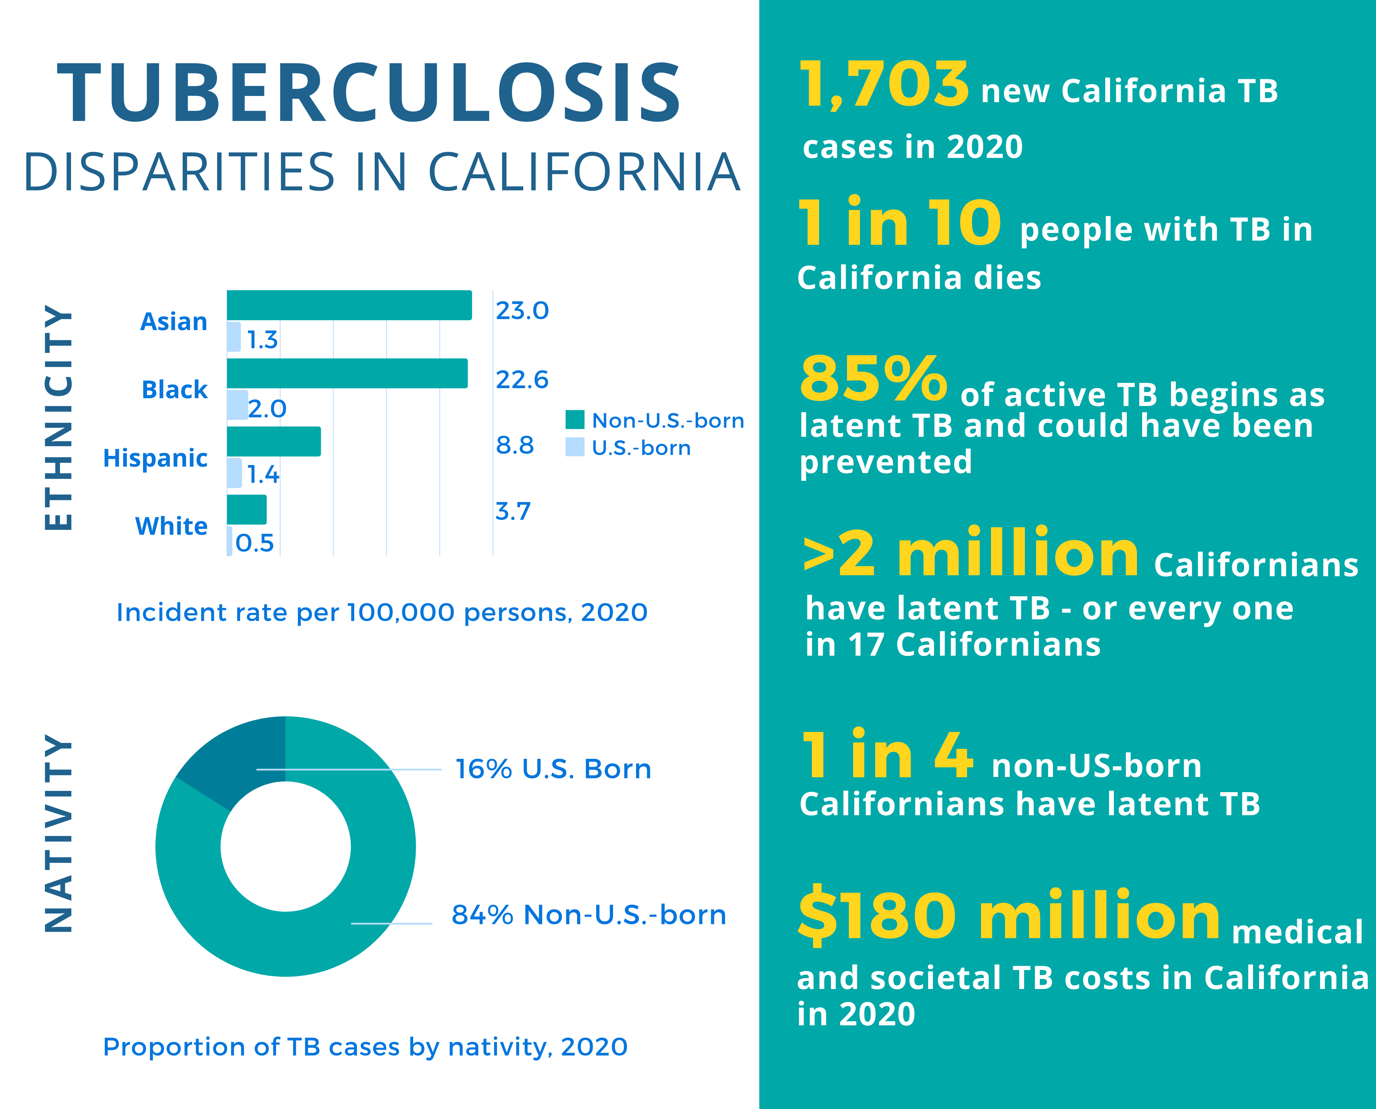
TB: by the numbers
Health insurance differs by country of birth, CHIS 2013-2015
Source: 2020 TB Snapshot; https://www.cdph.ca.gov/Programs/CID/DCDC/Pages/TB-Disease-Data.aspx
Notes:
Please refer to https://www.cdph.ca.gov/Programs/CID/DCDC/Pages/TB-Disease-Data.aspx for updated TB data.

Slide 8
One survivor’s perspective: why focus on LTBI?
“ If I had been sat down when I was 19 and told, ‘hey, you have latent TB, and if you don’t finish your treatment, it can develop into dangerous TB disease,’ I would have done so. It would have saved me a lot of grief in the future. It would have saved me seven months in isolation. So I think stopping TB at that initial stage, when it’s latent, and when you’re not infectious, I think is something that we need to educate more people about.”
- Khayr, a TB survivor
Source: CDC TB Personal Stories: https://www.cdc.gov/tb/topic/basics/Khayrstory.htm

Slide 9
What are the barriers?

Slide 10
Challenges for optimizing TB prevention cascade and scale-up
TB prevention not yet mainstreamed
Health systems and patient access not yet simple
Policies and funding not yet in place for large scale change
No national or statewide LTBI metric
Pandemic created pause in prevention activities (and TB evaluation/detection)
Lack of visibility and recognition of TB as an important problem. TB prevention not a valued intervention

Slide 11
What is needed?
National campaign with unified messaging to public and providers
National measures adopted across healthcare settings
Streamlined mechanism for LTBI tracking/reporting
Costs removed for TB tests and drugs
New funding streams to support above

Slide 12
What does the California Elimination Plan propose?

Slide 13
Health Equity Focus – TB Elimination Plan (2021-2025)

Slide 14
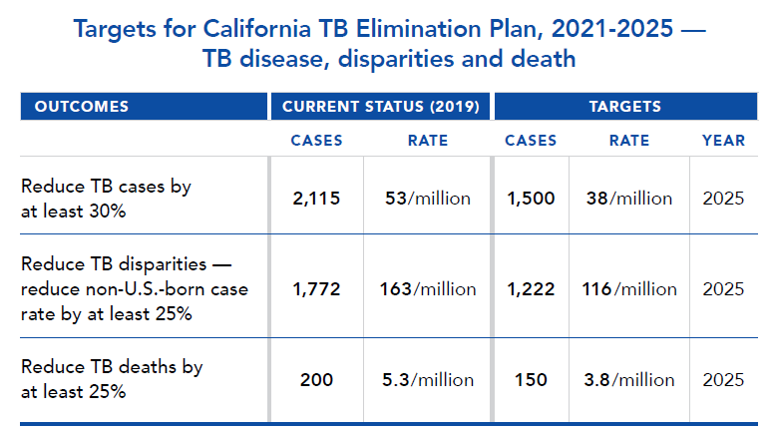
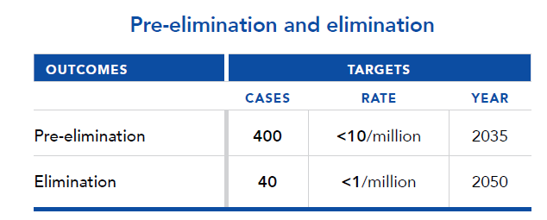
New targets

Slide 15
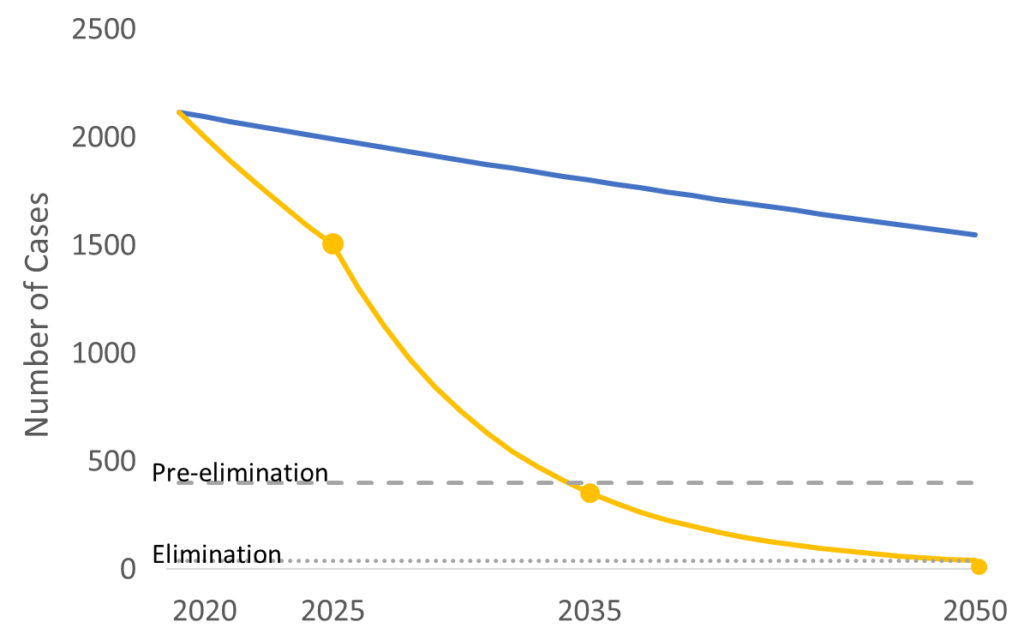
Status quo vs. intervention in CA
Health insurance differs by country of birth, CHIS 2013-2015
We can avert:
36,000 TB cases
3,600 deaths with TB
one billion dollars in medical costs
one billion dollars in societal costs
Sources:
Cost from Shephardson et al. inflated to 2020 dollars. Shepardson D, Marks SM, Chesson H, et al. Cost-effectiveness of a 12-dose regimen for treating latent tuberculous infection in the United States. Int J Tuberc Lung Dis. 2013.
Oh P, Pascopella L, Barry PM, Flood JM. A systematic synthesis of direct costs to treat and manage tuberculosis disease applied to California, 2015. BMC Res Notes. 2017.
Notes:
Compared to the status quo, if California reaches TB elimination by 2050, the state can avert 36,000 cases of TB disease and 3,600 deaths with TB and save one billion dollars in medical costs and an additional one billion dollars in societal costs.

Slide 16
5 recommendations (40 action steps)
Find and engage persons at high risk and providers
Apply effective strategies for LTBI testing and treatment
Develop a California LTBI surveillance system
Secure sufficient resources for Plan implementation
Conduct research to evaluation TB prevention strategies

Slide 17
Rec 1: Engagement
Outreach to priority primary care providers
Engage primary care medical organizations
Implement “CA TB Hero” program
Partner with health equity organizations
Train non-licensed health workers on TB prevention
Tailor communications to high risk populations
Integrate TB prevention messages into other materials
Support TB survivors’ efforts
Develop campaigns for AANHPI & Latinx populations
Select and post effective patient materials

Slide 18
Rec 2: LTBI testing and treatment
Produce and disseminate TB prevention “playbook”
Improve LTBI care cascades of community clinics
Disseminate LTBI care linkage steps to civil surgeons
Increase LTBI treatment of groups already tested
Couple LTBI and COVID prevention efforts
Enhance Medi-Cal Managed Care plans’ LTBI efforts
Promote TB prevention for DHCS Innovation Awards

Slide 19
Rec 3: Surveillance
Publish annual LTBI report
Map TB and COVID-19 cases
Establish statewide LTBI measures
Update Medi-Cal LTBI treatment completion rates
Implement statewide TB contact surveillance system
Enhance IGRA reporting to capture risk
Create EHR data flow for LTBI surveillance
Promote LTBI testing/treatment measurement
Promote USPSTF LTBI recommendations

Slide 20
Rec 4: Resources
Define necessary resources for 2021-2025 TB Elimination Plan
Develop TB prevention business case
Expand TB coalitions
Ensure coordination across CA TB elimination plans
Secure funding to support TB prevention efforts
Monitor inventory/price of rifamycin medications
Ensure all rifamycins are on Medi-Cal Rx formulary
Ensure full coverage of IGRAs by all CA health plans
Reduce TB prevention costs for healthcare systems

Slide 21
Rec 5: Research
Establish CA LTBI research network
Establish TB case and disparity reduction targets
Promote LTBI testing/treatment implementation research
Assess strategies to prevent LTBI care cascade attrition
Analyze non-traditional data on LTBI testing/treatment

Slide 22
Where to find the 2021-2025 Elimination Plan
Online: https://www.cdph.ca.gov/Programs/CID/DCDC/Pages/TBCB.aspx
Under the section “Advocacy and Partners for TB”

Slide 23
What is next?

Slide 24
Measuring LTBI testing and treatment outcomes

Slide 25
Prevention effectiveness: number needed to test and treat to prevent a TB case?
- Testing for LTBI is a recommended standard of care for asymptomatic non-US-born adults to prevent TB disease (USPSTF 2016)
- TB prevention is cost-effective especially if IGRA and short course regimens used
- Among non-US-born diabetics, 500 needed to screen and treat to prevent one TB case
- Meets acceptable threshold of willingness to pay

Slide 27
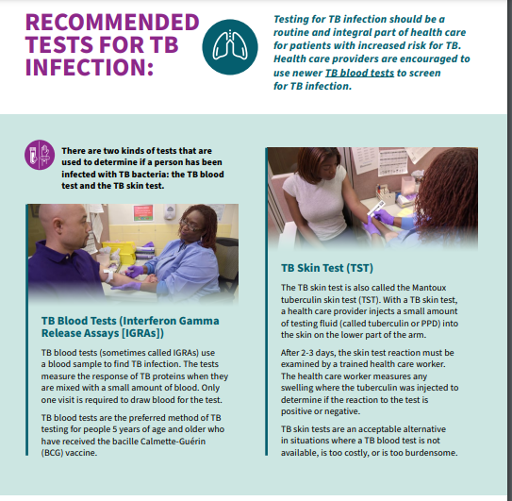
CDC recommends the following TB prevention best practices:
- IGRA as the preferred test
- Short course rifamycin-based LTBI treatment regimens as the preferred treatment
Source: https://www.cdc.gov/tb/publications/ltbi/pdf/CDC-USPSTF-LTBI-Testing-Treatment-Recommendations-508.pdf

Slide 28
Actions to make TB prevention routine
Action | Assurance
Use standardized risk assessment | Ensure residence / birth outside US is in EHR intake/history section
Use IGRA | Remove impediments to IGRA use
Ensure process for TB evaluation prior to LTBI treatment is streamlined | Easy access to chest x-ray and AFB culture
Ensure access to LTBI short course regimens whenever possible | Rifapentine on formularies
Track completion of LTBI treatment for those with positive test | Measure LTBI treatment completion
Provide access to expert TB resources for patients with complications/comorbidities | Ensure no barriers for referrals
Engage and and bring awareness to communities at risk | Measure understanding and acceptance for linkage to LTBI testing/rx

Slide 29
Opportunities
COVID innovations - can advance outreach, testing capacity, disparity focus for TB prevention
Synergies – partnerships with Diabetes and Hep B organizations to integrate LTBI testing and treatment
TBESC - research findings arm us with evidence for changing practice
Policy – partnership with Medi-Cal to remove barriers for LTBI testing and treatment for beneficiaries
4 California TB elimination plans (San Diego, San Francisco, Los Angeles, California) - can sharpen focus and amplify efforts and chances of reaching targets
Strengthen advocacy - include survivors and focus on disparities

Slide 30
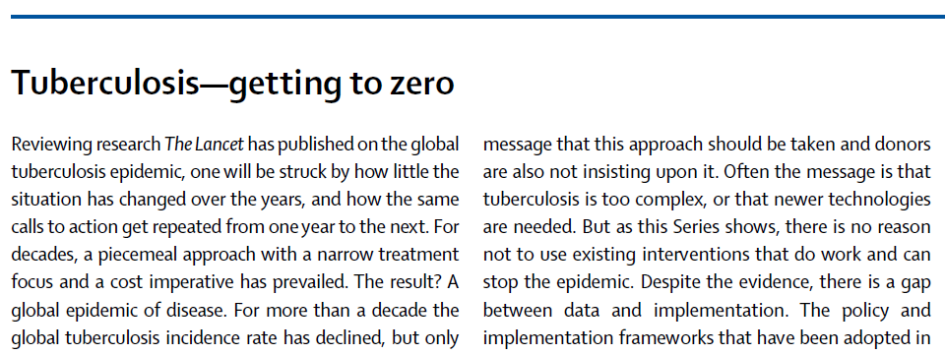
Tuberculosis -
getting to zero
“For decades, a piecemeal approach with a narrow treatment focus and a cost imperative has prevailed. The result? A global epidemic of disease….There needs to be a change in mindset.”
Source: The Lancet, UK, 2017
Pamela Das, Richard Horton

Slide 31
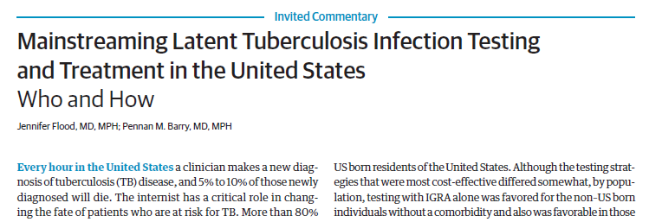
Mainstreaming LTBI Testing and Treatment in the United States
“With full adoption of TB prevention in primary care using currently available modern tools, we can progress from TB control to TB elimination…”
Source: Tuberculosis Control Branch, California Department of Public Health, 2017 JAMA Internal Medicine

Slide 32
Summary
- TB is deadly, costly, and disrupting lives in California
- The California TB Elimination Plan gives prevention traction
- TB survivors are critically important for communicating the potential TB prevention offers
- Visibility and attention to gaps needed
- Not over yet, but on our way

Slide 33
Discussion
Ideas to advance TB prevention?

Slide 34
Thank you !

Slide 35
EXTRA SLIDES

Slide 36
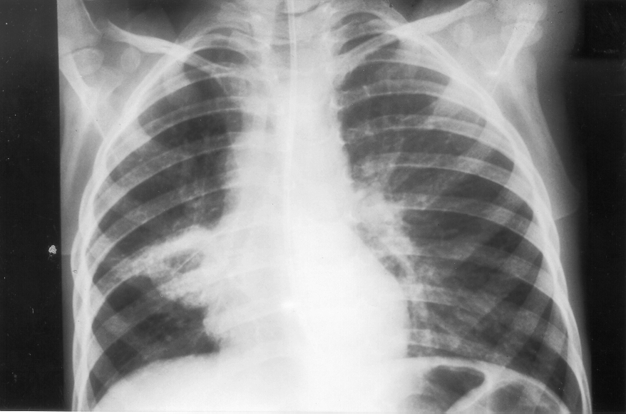
Most TB disease results from progression of latent TB infection after years
TB is preventable!

Slide 37
Natural History of TB
1 in 4 globally
have LTBI
Not infected
Exposure to infectious TB
Latent TB infection (LTBI)
years
Active TB disease
Rapidly develop
active TB disease
¹Miramontes R, et al. (2015) Tuberculosis Infection in the United States: Prevalence Estimates from the National Health and Nutrition Examination Survey, 2011-2012.
Notes:
"Based on NHANES data, CDC estimates that up to 13 million people in the United States have latent TB infection."
https://www.cdc.gov/tb/statistics/ltbi.htm#:~:text=Based%20on%20NHANES%20data%2C%20CDC,States%20have%20latent%20TB%20infection.

Slide 38
A – Clearance
B – Latent infection
C – Pulmonary infection (active)
D – Disseminated infection (active)
Spectrum of TB disease
Latent TB Infection
Absence of TB symptoms
Positive TST¹ or IGRA² result
Chest radiograph normal
Not infectious
Active TB Disease
Symptoms such as cough, fever
TST or IGRA is usually positive
Chest radiograph is usually abnormal
Respiratory specimens usually culture positive
¹TB skin test
²Interferon gamma release assay
Image: Dheda K. Lancet, 2016

Slide 39
LTBI testing is now
more accurate
Opportunity
Treatment is now shorter and safer
“ Scaling up LTBI treatment will be critical to drive down global TB incidence”, - WHO, 2019
Notes:
This time offers opportunity to prevent TB disease from occurring.
TB disease is preventable by testing and treatment.
Just recently our tests for TB infection became better and treatment is now much shorter and safer.

Slide 40
Who is caring for persons at risk for TB?
Health Departments
12,000 contacts
7,000 immigrants and refugees
Civil Surgeons
100,000 status adjusters
Primary care
FQHCs >5 million
Kaiser >9 million
Other >100,000
>5.2 (CA rate)
3.0-5.2
<3.0
Less than 5 cases
San Francisco
San Mateo
Alameda
Santa
Clara
Risk concentrated in
25 zip codes
Los
Angeles
Orange
San Diego
Notes:
To identify primary care providers, among thousands in CA, who serve high risk we investigated though a systematic process involving mapping of TB cases, non Usborn resident populations, using census health clinic data, languages used, and web scraping, we found 25 zip codes across 7 counties where nonUS born concentrated, and 150 clinics that provide care for these populations. These lists were disseminated for review and use by local TB programs.

Slide 41
Research: new evidence for action
TB Epidemiologic Studies Consortium:
IGRA is better predictor of TB disease
Baseline LTBI care cascade measured; barriers and facilitators identified
CDPH: contributed evidence for IGRA use in children
CDC TB modeling consortium- UCSF/ Harvard /Johns Hopkins:
Produced 3 models on strategies for elimination in California
Tabby 2 = model posted for use to examine effect of interventions
TB Treatment Clinical Trials Consortium (TBTC): 6 week LTBI rx
CDC: Effective messaging on TB prevention for community outreach

Slide 42
Notes:
Underpinning the successes of the last five years is the CDPH TB Free California project, the only statewide program with dedicated funding for TB prevention. The program’s goal is to increase testing and treatment of LTBI in order to prevent cases of TB disease. TB Free California works to train healthcare providers who serve high risk populations to measure LTBI testing and treatment completion in community clinical settings and provides patient education and engagement of populations at highest risk of LTBI. In addition, the project contributes to state and national efforts to build data systems that measure LTBI care.

Slide 43
California TB Case Count-
Jan-Nov, 2019-2021
*Yearly totals collected Nov 1 (2019, 2020, 2021)
**Counties are behind in reporting cases, so N for 2021 is an underestimate.

Slide 44
California Dead at Diagnosis -
Jan-Nov, 2019-2021

Slide 45
Increase in IGRA utilization TST and IGRA use, 2010-2019

Slide 46
Short-course LTBI therapy among immigrants and refugees with class B condition, Oct 2018-Sept 2020 (n=644)
76% were treated with 4 months of rifampin (4R) or 3 months of isoniazid + rifapentine (3HP)

Slide 47
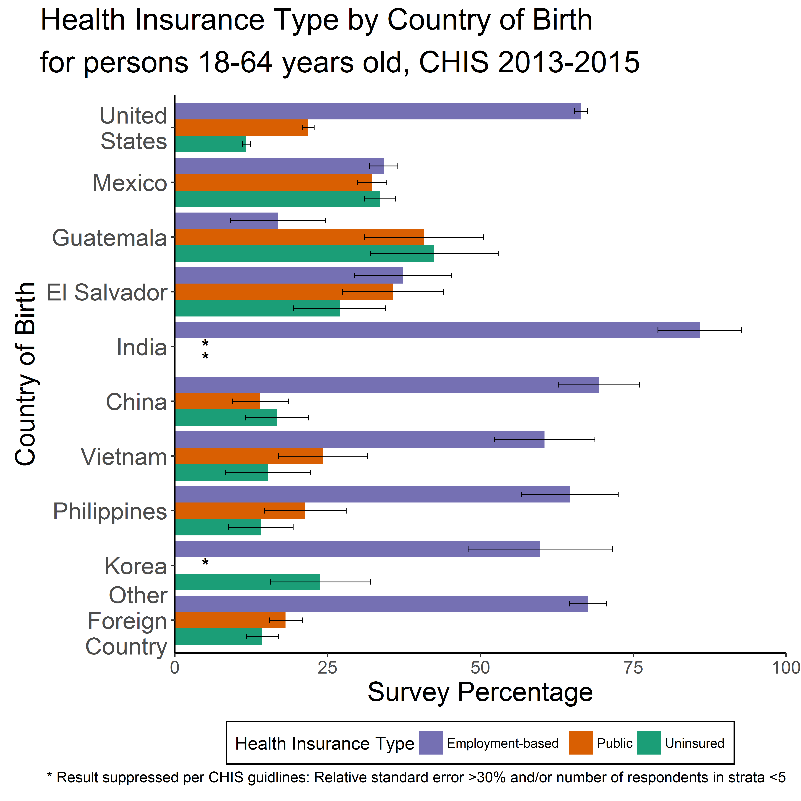
Health Insurance Differs by Country of Birth, CHIS 2013-2015
Readhead A, Barry P. Preparing for Latent TB Infection Testing Scale-up: Towards Identifying Providers to High-risk Populations among Non-U.S.-born Persons.
Poster presented at: National Tuberculosis Controllers Association Meeting; 2018 May 21-24; Palm Springs, CA
Notes:
This graphic presents another window into healthcare providers: these are data that show that Californians who are born in top countries of TB cases, differ in health insurance type. We know from past studies, close to 40 percent TB cases are medi-cal recipients; these data show if from top two countries you might equally likely to have public or private insurance . In contrast , those born in india predominantly had employer based private insurance. This is imporatnt information in strategy to support patients through care. So our strategy to engage providers cannnt be limited to public plans.

Slide 48
[INSERT LOCAL EPI SLIDES HERE]

