Slide 1
Transplant TB An academic center perspective
@PCH_SF
Peter Chin-Hong MD MAS
Professor of Medicine UCSF
March 2019

Slide 2
Disclosures
None

Slide 3
Objectives
List several ways in which organs are screened for infectious diseases in donors and recipients at transplant centers
Compare screening practices for TB in Solid Organ Transplant donors and recipients at various transplant centers in the U.S.
Review current guidelines for TB among Solid Organ Transplant recipients in the U.S.
Illustrate screening, diagnosis and treatment issues in TB in transplant recipients using case examples

Slide 4
Objectives
List several ways in which organs are screened for infectious diseases in donors and recipients at transplant centers
Compare screening practices for TB in Solid Organ Transplant donors and recipients at various transplant centers in the U.S.
Review current guidelines for TB among Solid Organ Transplant recipients in the U.S.
Illustrate screening, diagnosis and treatment issues in TB in transplant recipients using case examples

Slide 5
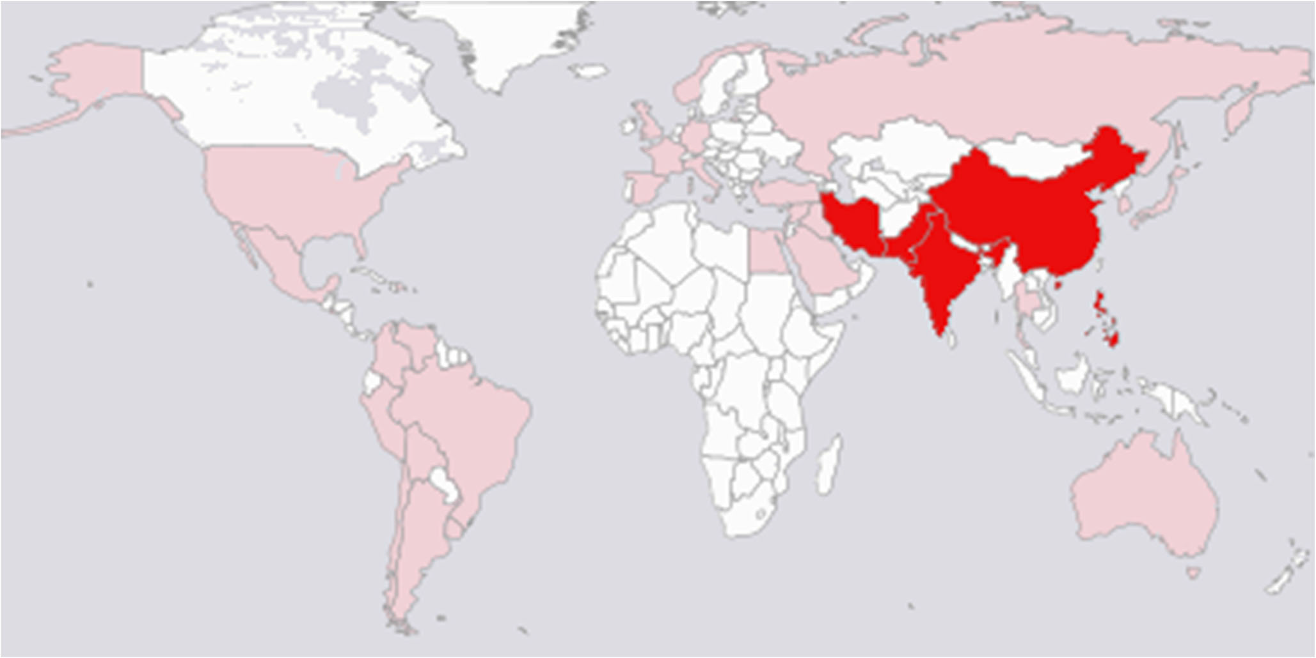
Where do organs come from?
“Transplant tourism”
Organ procurement organization
Living donors

Slide 6
Where organs come from determines ID screening
Ugly
“Transplant tourism”
Good
(kind of)
Organ procurement organization
Good
Living donors

Slide 7
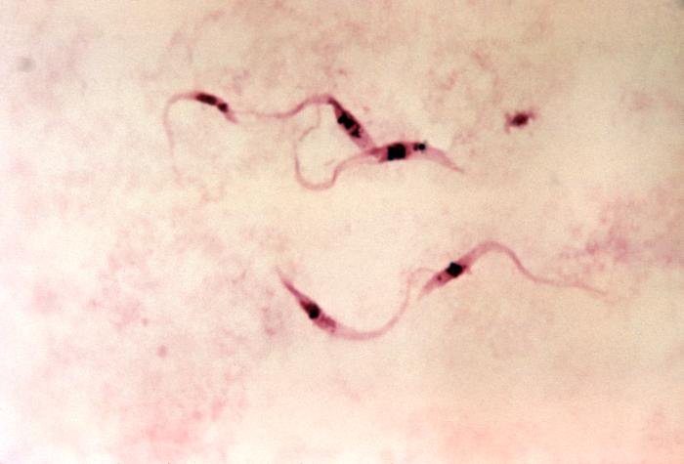
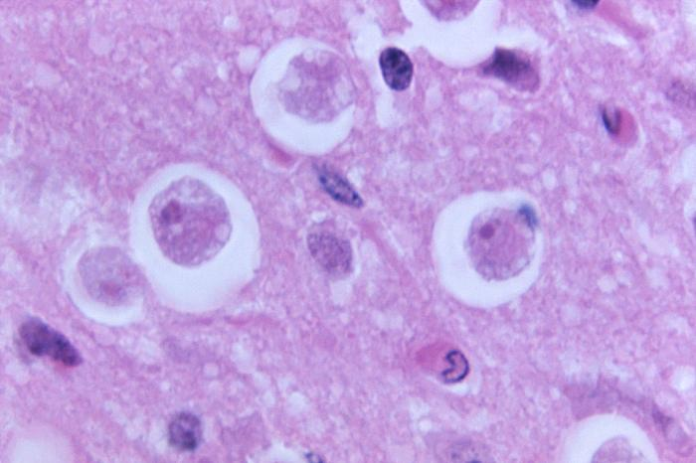
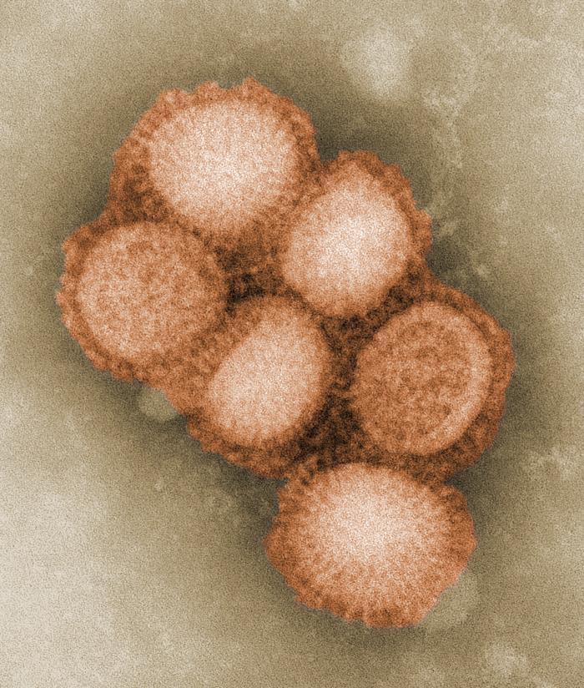
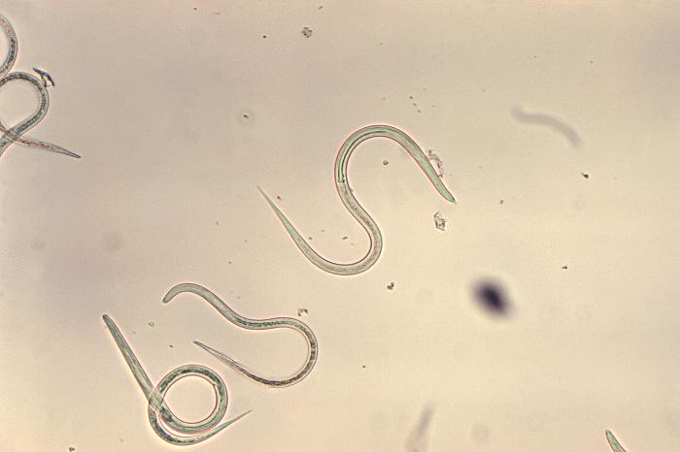
Case Which of these organisms is safe to transplant?
T. cruzi
Naegleria
H1N1
Strongyloides

Slide 8
Case Which of these organisms is safe to transplant?
T. cruzi
Naegleria
H1N1
Strongyloides
Chin-Hong et al, Am J Transplant. 2011; (11)4
Roy et al, Am J Transplant. 2014; (14)1
Kumar et al, Am J Transplant. 2010; (10)1
Chin-Hong et al, ATC 2013

Slide 9
Donor-derived infections
Potential transmission events reported to UNOS/DTAC

Slide 10
How does ID help with screening?
Ensure donor screening performed
Review medical & social history
Physical examination
Screening of blood samples of donor and recipient
Serology
Nucleic Acid Testing (NAT)
Define the increased risk donor
OPTN-defined increased risk donor
Not all risk is the same
Increased risk of transmission of other infections may affect peri-transplant antimicrobials
Screen high-risk recipients post-transplant
Transplant ID supper club at ID week 2018

Slide 11
What is screened?
The “Big 3”: HIV, Hep B, Hep C
The givens: CMV, EBV, HSV, VZV, toxoplasma, syphilis, bacteria
The “Next 3”: TB, Chagas, endemic mycoses
More a la carte: Strongyloides, West Nile
The impossibles: LCMV, microsporidia
Hocevar S et al, Ann Intern Med; 2014; 160(4)
Kotton C, Ann Intern Med; 2014; 160(4)

Slide 12
Objectives
List several ways in which organs are screened for infectious diseases in donors and recipients at transplant centers
Compare screening practices for TB in Solid Organ Transplant donors and recipients at various transplant centers in the U.S.
Review current guidelines for TB among Solid Organ Transplant recipients in the U.S.
Illustrate screening, diagnosis and treatment issues in TB in transplant recipients using case examples

Slide 13
Data
16 Organ Procurement Organizations
17 Transplant Centers
Notes:
I contacted 17 transplant centers representing 16 OPOs

Slide 14
LTBI screening OPO deceased donors
58 OPOs organized in 11 regions
Notes:
58 OPOs organized in 11 regions

Slide 15
LTBI screening OPO deceased donors
OPOs doing any LTBI screening = 13% (2/16)
[Both targeted screening using IGRA: CA, AL]
Notes:
58 OPOs organized in 11 regions

Slide 16
“No, our OPO doesn't test. That's typical of the vast majority of OPO's, and driven out of the sense that the sensitivity at point of terminal illness was poor. A Texas OPO a few years ago tried to IGRA all of their donors (who should have been higher risk in Texas?) and in the end got a bunch of borderline positives they didn't know what to do with. Not sure that ever got published...”
North Carolina center

Slide 17
“We [the OPO] doesn’t know what to do with the indeterminate so [we] have to report them all through the disease transmission portal and make 1 billion phone calls”
California Organ Procurement Organization
Donor Network West sent 39 IGRA since 2019: 70% indeterminate, 3% positive

Slide 18
LTBI screening Transplant center living donors
N=17: UW, UCSF, Stanford, UCLA, Northwestern, Mayo, U Toronto, MGH, UMass, Yale, Penn, Hopkins, Duke,
UAB, Miami, UT Southwestern, Ochsner
Notes:
58 OPOs organized in 11 regions

Slide 19
LTBI screening Transplant center living donors
Transplant centers doing any LTBI screening = 100% (17/17)
[Universal screening=82% (14/17); IGRA=92%; most use QFN-Gold]
Notes:
Toronto uses universal TST; Duke uses targeted TST. Everyone else IGRA.

Slide 20
LTBI treatment Transplant center organ recipients
Transplant center regimens (pre): INH 6-9mo; Rif 4mo; INH/RFP 12x (35%; 6/17)
Transplant center regimens (post): INH 6-9mo; quinolone (18%; 3/17)
Many treat livers post-transplant for fear of decompensation if pre-tx
Notes:
58 OPOs organized in 11 regions

Slide 21
“This is a big problem for me. I would like to get this latent TB thing done with and not have it hang over the patient like a Sword of Damocles, liable to come crashing down at any moment. However, I have memorable experiences where I almost lost a patient to liver failure induced by INH or rifampin as they were on the waiting list”
Maryland center

Slide 22
Objectives
List several ways in which organs are screened for infectious diseases in donors and recipients at transplant centers
Compare screening practices for TB in Solid Organ Transplant donors and recipients at various transplant centers in the U.S.
Review current guidelines for TB among Solid Organ Transplant recipients in the U.S.
Illustrate screening, diagnosis and treatment issues in TB in transplant recipients using case examples

Slide 23
Guidelines
NONE
Grumpy cat

Slide 24
Guidelines
IDSA/ATS (2016): Nothing on solid organ transplantation
ID community of practice, American Society of Transplantation (2013) [review, not guideline]: “It is not possible to accurately perform TST or IGRA on deceased donors, but a history should be obtained from the donor's family or relatives of previous active TB and any associated treatment. Ideally, it would also be desirable to know if the donor had exposure to active TB within the last 2 years.”
Lewinsohn D et al, 2017, CID, 64(2)
Subramanian A et al, 2013, AJT, 13(4)

Slide 25
Objectives
List several ways in which organs are screened for infectious diseases in donors and recipients at transplant centers
Compare screening practices for TB in Solid Organ Transplant donors and recipients at various transplant centers in the U.S.
Review current guidelines for TB among Solid Organ Transplant recipients in the U.S.
Illustrate screening, diagnosis and treatment issues in TB in transplant recipients using case examples

Slide 26
Case
67 year-old man with a history of Crohn disease and RA-associated interstitial lung disease s/p bilat lung transplant
Presents with 1 week L sided chest pain, fevers, chills, and 8 weeks fatigue and productive cough
Chest CT with effusions and lymphadenopathy, and echo showed new large pericardial effusion
An intervention was performed
Chest CT showing L>R pleural effusions
and L hilar lymphadenopathy

Slide 27
Case
Pericardial window and biopsy
Pleural fluid drained: AFB culture M. TB
Started on RIPE then INH/rifampin for 9 months after susceptibility testing
Pericardial biopsy showing granuloma

Slide 28
Case Investigation
Donor: s/p MVA. Chest CT showed diffuse nodules. OPO suspicious for TB and performed TST (neg) and IGRA (indeterminate). Sputum AFB neg cx. Born in Guatemala. Previous incarceration
Recipient: No TB risk factors
Pre-donation questionnaire asked next-of-kin about TB symptoms, prior TB and TB testing. None recalled by family
6 organs eventually transplanted into 4 patients
County and state DPH involved when three other cases matched genotype of transplant donor and recipient
Donor found to have converted from negative to 18mm TST while incarcerated in 2010. This information not known to OPO
Kay A et al, 2017, MMWR, 66(30)

Slide 29
“We do not perform this type of screening [IGRA/TST] but it is covered in the medical/social history. If the Donor Risk Assessment Interview is positive for living with a person with TB or have a history of TB or positive skin/blood test, we follow up with treatment investigations.”
Maryland Organ Procurement Organization

Slide 30
Future directions?

Slide 31
“You know you could actually do a survey and it could be quite interesting on this topic. Some folks say they treat everyone prior to transplant. It would be interesting to sample clinical practice. Fortunately, reactivation tuberculosis rates are low. Except for last week on our bone marrow transplant unit…”
Massachusetts center

Slide 32
Summary
List several ways in which organs are screened for infectious diseases in donors and recipients at transplant centers
Compare screening practices for TB in Solid Organ Transplant donors and recipients at various transplant centers in the U.S.
Review current guidelines for TB among Solid Organ Transplant recipients in the U.S.
Illustrate screening, diagnosis and treatment issues in TB in transplant recipients using case examples

